Slide 1
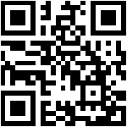


Beyond Budgets – Modern Gambling, Gray Areas, and Guardrails from a Financial Perspective
Wednesday 10:15am – 11:45am
Thank you to Northwest ATTC for co-sponsoring this session.
Please scan the QR code below to access the GRPA survey. Please complete this evaluation for the sponsors, in addition to the conference evaluation either on the colored printed sheets at your table or via the app.

Slide 2






Beyond Budgets – Modern Gambling, Gray Areas and guardrails from a Financial Perspective
Powered by
Financial counseling for problem gambling
Notes:
Introduce
Want this to be interactive
Has everyone heard of GamFin?

Slide 3

Michael Spear is a Certified Financial Planner™ uniquely positioned at the intersection of wealth management and mental health. With two decades of experience in relationship management, strategy, sales and leadership with roles at Charles Schwab and UBS, Michael is now currently pursuing an MS in Clinical Mental Health Counseling and actively completing an inpatient residential practicum with a large Indianapolis hospital.
Michael Spear, CFP®
GamFin Financial Counselor
Powered by
Financial counseling for problem gambling
Notes:
Introduce
Want this to be interactive!
Has everyone heard of GamFin?

Slide 4

Session Objectives
Map of Today’s Landscape: Understanding modern forms of high-speed speculation.
Investing vs Gambling: How the lines are being blurred and contrasting with healthy financial literacy.
How our Children are impacted: How young children are able to gamble and guardrails.
GamFin
Notes:
New Landscape Examples: sports/iGaming, prediction markets, and brokerage-embedded event contracts.

Slide 5
Cognitive Considerations
Powered by
Financial counseling for problem gambling
Notes:
Introduce
Want this to be interactive
Has everyone heard of GamFin?

Slide 6

The Literacy Gap: Understanding vs. Believing
A person struggling with a gambling disorder often has high Gambling Literacy regarding the games they play. They might know the odds, the house edge and the mechanics of a parlay. However, problem gambling involves a breakdown in applying that literacy.
The Literacy Paradox
Systemic Failure
GamFin
Notes:
Let’s start with some of the cognitive discrepancy.
"By a show of hands, how many of you have treated a client who can calculate the odds of a 5-leg parlay faster than you can use a calculator, but they still cannot figure out how to pay their rent?“
The Literacy Paradox: Many gamblers can recite the mathematical probability of a win, yet they succumb to the "Gambler’s Fallacy"—the belief that if a coin has landed heads five times, it is "due" to land tails.
Systemic Failure: Financial literacy tells you that the "house always wins" in the long run ($EV < $0). Problem gambling creates a cognitive dissonance where the individual believes they are the exception to that rule.

Slide 7

Risk vs. Reward Neurobiology
When putting money at risk in a healthy way, risk and reward are balanced based on logic. In problem gambling, the Reward side of the brain (dopamine) hijacks the Risk side of the brain (prefrontal cortex).
Asymmetric Risk
Chasing Losses
GamFin
Notes:
Asymmetric Risk: To a healthy observer, risking one’s rent money for a 10% chance at a jackpot is an irrational risk. To a problem gambler, the "reward" isn't just the money—it’s the relief from the urge or the "high" of the action.
Chasing Losses: This is the ultimate distortion of risk/reward. The "reward" shifts from "winning extra money" to "getting back to even." To achieve this, the gambler takes exponentially higher risks, often leading to a total financial collapse.

Slide 8
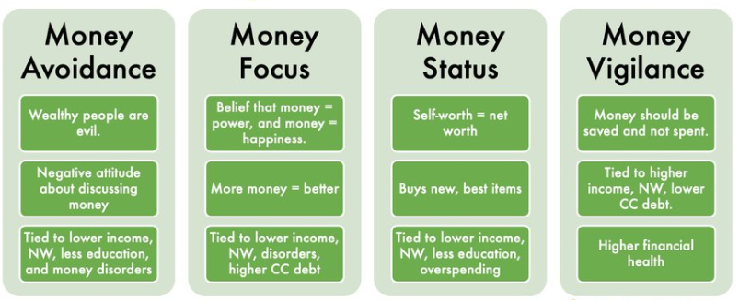
Psychology of Money
GamFin
Money Scripts Bradley T. Klontz, Psy.D., CFP®
Notes:
Money script is an unconscious belief about money

Slide 9
Psychology of Money: Money Scripts
1. When I think about wealthy people, my initial subconscious thought is:
A) They probably compromised their values or took advantage of others to get there.
B) They have the power and freedom to be truly happy.
C) Their high net worth is a direct reflection of their hard work and personal value.
D) They shouldn't flash their wealth; money is a private matter.
GamFin
Money Scripts Bradley T. Klontz, Psy.D., CFP®
Notes:
Money script is an unconscious belief about money

Slide 10
Psychology of Money: Money Scripts
2. When it comes to my own spending and saving habits:
A) I try to avoid looking at my bank accounts or thinking about my finances because it stresses me out.
B) I constantly feel like if I just made a little bit more money, my problems would be solved.
C) I prefer buying the newest, best, or name-brand items because it shows I am doing well.
D) I find it difficult to spend money, even on things I can easily afford and enjoy.
GamFin
Money Scripts Bradley T. Klontz, Psy.D., CFP®
Notes:
Money script is an unconscious belief about money

Slide 11
Psychology of Money: Money Scripts
3. If I receive a sudden, unexpected windfall of $10,000, my immediate instinct is to:
A) Feel slightly guilty or anxious about having it, maybe wanting to give it away quickly.
B) Use it as a stepping stone to make even more money.
C) Upgrade my lifestyle immediately (a nicer car, a luxury vacation, designer clothes).
D) Lock it away in a savings or retirement account and pretend I never got it.
GamFin
Money Scripts Bradley T. Klontz, Psy.D., CFP®
Notes:
Money script is an unconscious belief about money

Slide 12
Psychology of Money: Money Scripts
4. How does money impact your view of relationships and self-worth?
A) Talking about money with family or friends is inherently rude or inappropriate.
B) I deeply admire people who make a lot of money and want to be in their circle.
C) If I buy people nice gifts or pick up the tab, they will think highly of me.
D) I tend to quietly judge people who carry credit card debt or fail to save responsibly.
GamFin
Money Scripts Bradley T. Klontz, Psy.D., CFP®
Notes:
Money script is an unconscious belief about money

Slide 13
Psychology of Money: Money Scripts
5. How would you define ultimate financial success for yourself?
A) Having just enough to get by so I never have to focus on money again.
B) Reaching a point where my wealth gives me ultimate power and control over my life.
C) Having a visible net worth that proves my success to myself and others.
D) Having absolutely zero debt and an over-funded emergency savings account.
GamFin
Money Scripts Bradley T. Klontz, Psy.D., CFP®
Notes:
Money script is an unconscious belief about money

Slide 14
Psychology of Money: Money Scripts
Mostly A’s = Money Avoidance: You view money as a source of stress or potentially corrupting.
Mostly B’s = Money Focus: You believe money equals happiness and solves problems.
Mostly C’s = Money Status: Self worth = Net worth.
Mostly D’s = Money Vigilance: Secretive, frugal and prioritize saving above all else.
GamFin
Money Scripts Bradley T. Klontz, Psy.D., CFP®
Notes:
Money script is an unconscious belief about money

Slide 15
Psychology of Money: Money Scripts
Avoidance of having necessary, tough financial boundary conversations.
Minimizing the emotional distress of a client who is wealthy, but struggling with addiction.
Over-empathize with the "Hustle Narrative" or “Day-trading” culture.
Difficulty empathizing with a client who is recklessly gambling away their rent.
GamFin
Money Scripts Bradley T. Klontz, Psy.D., CFP®
Notes:
Money script is an unconscious belief about money

Slide 16
Comparison of Healthy vs Problem Gambling
Concept | Healthy | Problem Gambling
Risk Assessment | Only wagering what can be afforded to lose. | Wagering essential funds (rent, bills) out of desperation.
Probability | Understanding that the house has a 5% edge. | Belief that the system can be beat with strategy.
The Reward | Entertainment! | Short-term dopamine hits and "escape" from reality.
Reaction to Loss | Acceptance | Panic and the immediate urge to "bet bigger" to recover.
GamFin
Notes:
Just like in substance use like alcohol there are many people who are able to manage the dangers and risks of alcohol.
What are some other cognitive discrepancies you have seen in problem gambling?

Slide 17
Today’s Landscape
Powered by
Financial counseling for problem gambling
Notes:
Introduce
Want this to be interactive
Has everyone heard of GamFin?

Slide 18
From Discount Brokers to “Gamified” Trading
1975:
“May Day” Eliminated standard commission trades
Self directed Client
1990s – 2000s:
Online Trading Era
Self-Directed Client
Smartphone
2010s – Present: Gamification of Trading
Robinhood introduced $0 stock trading and all other firms else followed
Sports betting, prediction markets and ALL trading all in one app
App design mirrors gaming and gambling mechanics
GamFin
Notes:
I think everything comes back to the smartphone

Slide 19
Why Brokerage Accounts Feel Like Vegas
Gamification of UI: Trading apps use classic "operant conditioning" techniques:
Confetti animations
Bright colors
Push notifications
Instant Gratification: Trading is now immediate, allowing for high-risk, short-term activity. Example: Trading 0DTE (zero days to expiration) options from a phone.
Access to Leverage: Easy access to complex derivatives and high leverage (especially in crypto) amplifies both the thrill and the financial ruin.
The “Hustle” Narrative: Social media rebrands high-risk speculation as "financial literacy." Losing money is framed as "paying tuition to the market."
GamFin

Slide 20
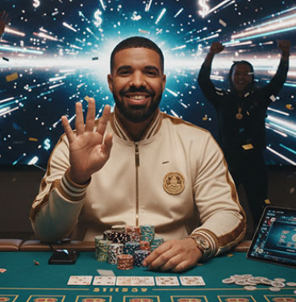
Hustle Narrative – Is it real?
A recent investigation by Bloomberg has raised questions about the gambling results of rapper Drake on the cryptocurrency casino Stake.
After reviewing extensive livestream footage, the publication concluded that Drake secured large payouts on certain games at a rate far exceeding that of typical users. Stake has rejected the findings, calling them inaccurate, while legal challenges against the company and some of its celebrity promoters continue in several U.S. states.
GamFin
Notes:
Have any of your clients or kids mentioned influencers?

Slide 21
Why Brokerage Accounts Feel Like Vegas: Vocabulary
The Language: Vocabulary on platforms like r/WallStreetBets is indistinguishable from a craps table:
  "YOLO-ing": Putting an entire life savings into a single, high-risk trade.
  "Diamond Hands": Refusing to sell an asset even as its value craters (chasing losses).
  "Tendies": The "winnings" or profits.
  "Buying the Dip": Mantra to justify doubling down on a losing position.
GamFin

Slide 22
Why Brokerage Accounts Feel Like Vegas: High-Risk Assets
Meme Stocks (GME, AMC):
  The underlying company value became irrelevant.
  Users were betting on a "short squeeze," turning it into a multiplayer game to "beat the house.“
Cryptocurrency and "Memecoins" (Dogecoin, Pepecoin):
  Lack intrinsic cash flow or utility.
  Operate on Greater Fool Theory (hope to sell at a higher price later)—effectively a high-speed lottery.
0DTE Options:
  Expire the same day they are bought.
  The financial equivalent of a "scratch-off" ticket—cheap, massive payout potential, but most expire worthless.
GamFin
Notes:
Questions on Crypto

Slide 23
Prediction Markets vs Sports Betting
Sports betting pits you against a bookmaker. Prediction markets are directly with other users.
Sportsbooks set odds to balance their risk and include a built-in margin. Prediction markets rely on user activity to set prices and charge a fee.
Sports betting is regulated state-by-state as “gambling.” Prediction markets operate federally as “derivatives” or “event contracts.”
Sportsbooks give a W2-G while Predictions Markets give 1099s.
GamFin
Notes:
What is one other important factor? AGE

Slide 24
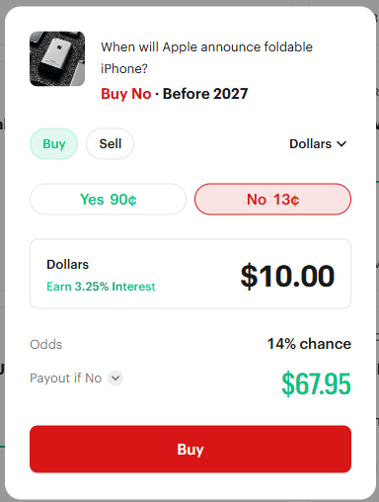
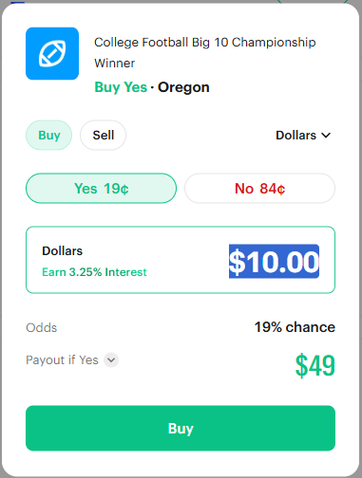
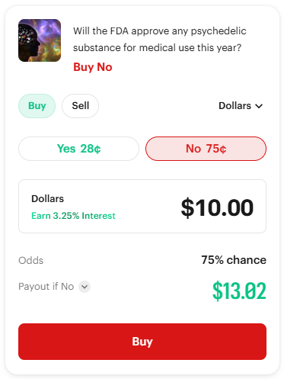
Powered by
Financial counseling for problem gambling
Notes:
Introduce
Want this to be interactive
Has everyone heard of GamFin?

Slide 25
Investing vs. Gambling: The Undeniable Differences
Feature | Investing | Gambling
Expected Value | Generally positive over longterm (the market grows). | Generally negative (the house always wins).
Risk Management | Diversification to minimize loss. | All-or-nothing outcomes.
Time Horizon | Years or decades. | Minutes, hours, or days.
Economic Role | Provides capital to businesses to create value. | Transfers wealth from one person to another.
GamFin
Notes:
Remember the neurobiology

Slide 26
Minors and Gambling
Powered by
Financial counseling for problem gambling
Notes:
Introduce
Want this to be interactive
Has everyone heard of GamFin?

Slide 27

The New Digital Concern: Minors
The line between mainstream video gaming and gambling has become incredibly thin, with technology outpacing regulation.
The modern "gambling" experience is digital, not a traditional casino setting.
GamFin
Notes:
Just as the lines with investing and gambling have become blurred, so to has gaming and gambling
How many would say they see more problem gambling behavior associated with digital vs in-person casino’s?

Slide 28
Complex and Grey Market Access
The Asset: Digital items ("skins") in games like Counter-Strike have a real-world monetary value via platforms like Steam Community.
The Process: Minors link their game accounts to unregulated, third-party websites to bet these skins on professional matches or roulette-style games.
The Issue: These sites operate in "grey markets" outside of standard financial oversight, meaning age verification is frequently bypassed.
GamFin

Slide 29
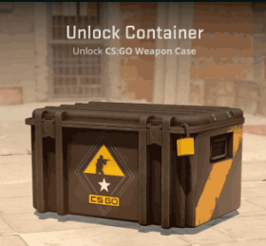
Gambling-Like Examples in Gaming
1. The "Loot Box"
Mechanism: Players spend real money on a "digital crate" (loot box/gacha system) with a randomized, variable reward.
The Danger: This uses the same variable ratio reinforcement (the thrill of the "near miss") found in slot machines to keep players buying.
2. Social Casino Games
Mechanism: Smartphone apps simulate casino games (slots, blackjack) using virtual currency that can be purchased with real money.
The Danger: These apps normalize the sounds, visuals, and mechanics of gambling before a child is old enough to understand the real-world risks and odds.
GamFin

Slide 30

Gambling-Like Examples in Gaming: Game Skins
The AK-47 Case Hardened skin #661 from Counter Strike 2
GamFin

Slide 31
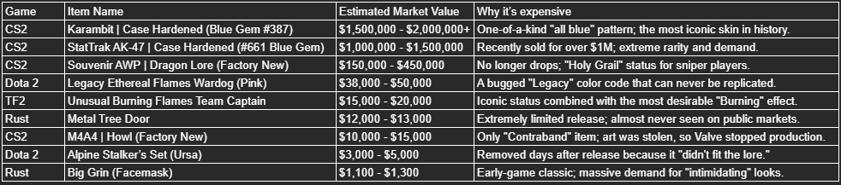
Examples
GamFin

Slide 32

Bypassing Age Verification
Identity Borrowing: Using a parent’s ID or social security number to create an account.
Crypto Casinos: Offshore gambling sites that accept cryptocurrency often lack "Know Your Customer" (KYC) requirements.
No Verification Casinos: Ex: Ignition
VPNs (Virtual Private Networks): Used to access sites that are restricted in their geographic region.
GamFin

Slide 33
Funding Sources
Identity Misuse & Family Accounts:
Linked Credit Cards: Using a parent’s card saved on a shared device (iPad, PlayStation) to buy "gems" or "points" with one click.
Identity Theft: Teens using a parent’s ID/Social Security Number to open a "verified" sportsbook account.
Cryptocurrency (The Ultimate Workaround):
Decentralized wallets do not require ID verification.
Crypto is bought from a friend or ATM and sent directly to offshore casinos that do not require identification.
GamFin

Slide 34
Putting it together: A Pipeline
The 2026 digital economy enables minors to move "liquid capital" without traditional bank accounts via peer-to-peer apps and digital assets.
Receive a gift card (“gateway") it is bought with cash and then untraceable.
Purchase a Loot Box and win a skin.
Transfer the skin to a marketplace (ex: Skinflow) and liquidate into cash or cypto.
Withdrawal cash/crypto via non-custodial crypto wallets (ex: Coin Wallet).
Deposit into a no-verification casino.
GamFin
Notes:
"When parents ask me, 'How is my 15-year-old gambling when he doesn't even have a checking account?' this is the exact pipeline I show them. To us, a $50 gift card from Target is just a birthday present. To a tech-savvy teen, it is step one in a money-laundering sequence. They use the video game to convert the gift card into a digital asset, liquidate that asset on a marketplace, move the funds through a decentralized rail like Breez or a crypto wallet, and drop it straight into an offshore casino. The financial system never sees it, and the parents never see it, because the money never touched a traditional bank.“
"Looking at this pipeline, at which of these five steps do you think a parent has the highest probability of actually catching the behavior?"

Slide 35
Practical Parental Steps
Adaptation of Traditional Financial Literacy: It focuses on long-term strategy and compound interest, but fails to address the acute, gamified and addictive nature of speculative entertainment.
Guardrails Focus: A practical intervention for problematic gambling that controls access and manages flow. Spending caps on specific gaming platforms (e.g., PlayStation, Xbox, Steam) to limit the purchase of virtual currencies and loot boxes.
Use tools like LifeLock, Aura, Monarch Money, etc. to create alerts
GamFin

Slide 36

Red Flags for Parents
Watch For:
Frequent, unexplained small ($5–$20) transfers on Venmo or Cash App to the same person.
Finding discarded "Visa Prepaid" or "Steam" gift cards.
High interest in the value of in-game items ("skins") over playing the game itself.
Unusual PayPal activity, as it is often a "middleman" for grey-market gambling sites.
GamFin

Slide 37
Closing
What are your takeaways?
What is a new clinical question you might want to add to an assessment?
GamFin

Slide 38
Powered by
Financial counseling for problem gambling
Notes:
Introduce
Want this to be interactive
Has everyone heard of GamFin?

Slide 39
Beyond Budgets – Modern Gambling, Gray Areas, and Guardrails from a Financial Perspective
Wednesday 10:15am – 11:45am
Thank you to Northwest ATTC for co-sponsoring this session.
Please scan the QR code below to access the GRPA survey. Please complete this evaluation for the sponsors, in addition to the conference evaluation either on the colored printed sheets at your table or via the app.

