Slide 1

Gambling as Escape
Problem gambling and other financially risky behaviors among people with PTSD/trauma
Gabriella Grant, Director
Trauma Informed California

Slide 3
Agenda
Understand the scientific nexus between trauma, problem gambling and other financially risky behaviors.
Explore unsafe behaviors as a treatable trauma symptom.
Use a financial risky behavior scale to help clients safety plan

Slide 4
Core Texts
Trauma and Recovery, Judith Herman (book)
Seeking Safety, Lisa Najavits (tx manual), https://www.treatment-innovations.org/seeking-safety.html
SAMHSA’s TIP 57, Trauma-Informed Care in Behavioral Health Services, https://library.samhsa.gov/sites/default/files/sma14-4816.pdf
SAMHSA’s Concept of Trauma and Guidance for a Trauma Informed Approach, https://www.nctsn.org/sites/default/files/resources/resource-guide/samhsa_trauma.pdf
SAMHSA’s Practical Guide for Implementing a Trauma-Informed Approach, https://ia800607.us.archive.org/7/items/tr-inf-care/tr%20inf%20care.pdf
Beyond Trauma, Stephanie Covington (tx manual), https://www.stephaniecovington.com/books/bookstore/beyond-trauma-a-healing-journey-for-women-2nd-edition/
Using Trauma Theory to Design Service Systems, Harris & Fallot (book)
Responding to Childhood Trauma: The Promise and Practice of Trauma Informed Care, Gordon R. Hodas, MD, https://www.pa.gov/content/dam/copapwp-pagov/en/dhs/documents/contact/dhs-offices/documents/Responding%20to%20Childhood%20Trauma%20The%20Promise%20and%20Practice%20of%20Trauma%20Informed%20Care.pdf

Slide 5
Essential Reading
This list and more resources are in the Compendium!
Healing Self-Injury: A Compassionate Guide for Parents and Other Loved Ones by Janis Whitlock, PhD and Elizabeth Lloyd-Richardson, PhD, 2019
The Tender Cut: Inside the Hidden World of Self-Injury by Patricia A. Adler and Peter Adler, 2011
Women Who Hurt Themselves: A Book of Hope and Understanding by Dusty Miller, 10th anniversary edition, 2005
Self-Injury: Psychotherapy with People Who Engage in Self-Inflicted Violence by Robin E. Connors, 2000
Bodily Harm: The Breakthrough Healing Program for Self-Injurers by Karen Conterio and Wendy Lader, PhD with Jennifer Kingson Bloom, 1999
The Scarred Soul: Understanding & Ending Self-Inflicted Violence by Tracy Alderman, PhD, 1997

Slide 6
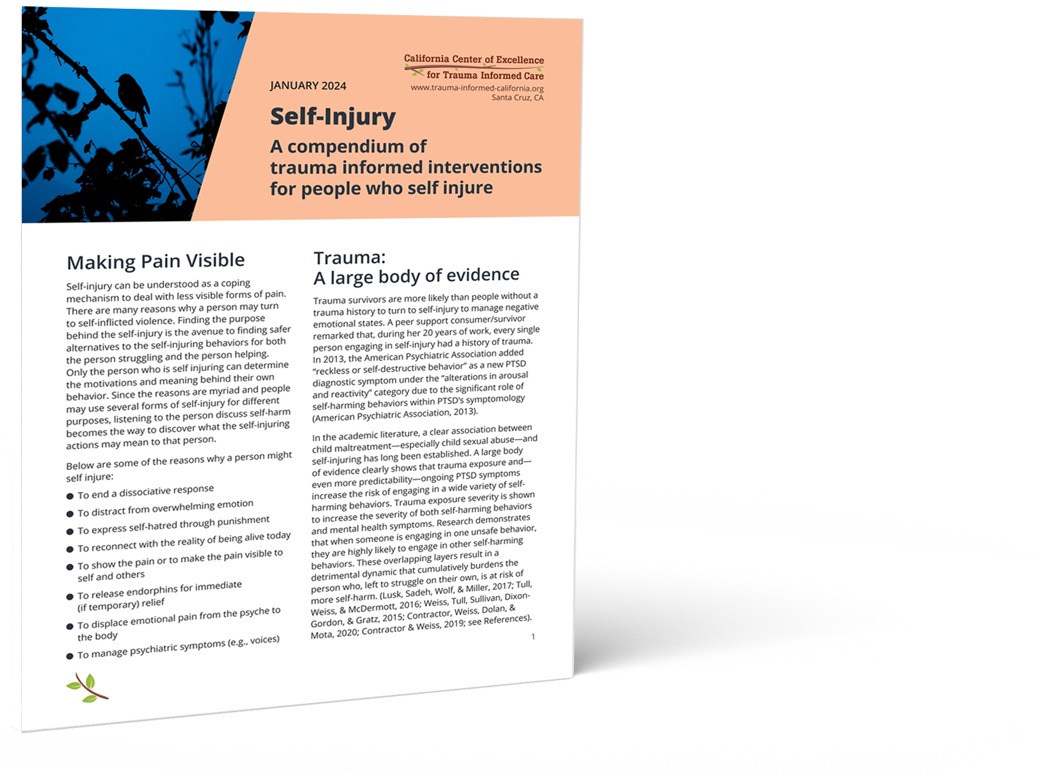
Self-Injury
A compendium of trauma informed interventions for people who self injure (2024)

Slide 7
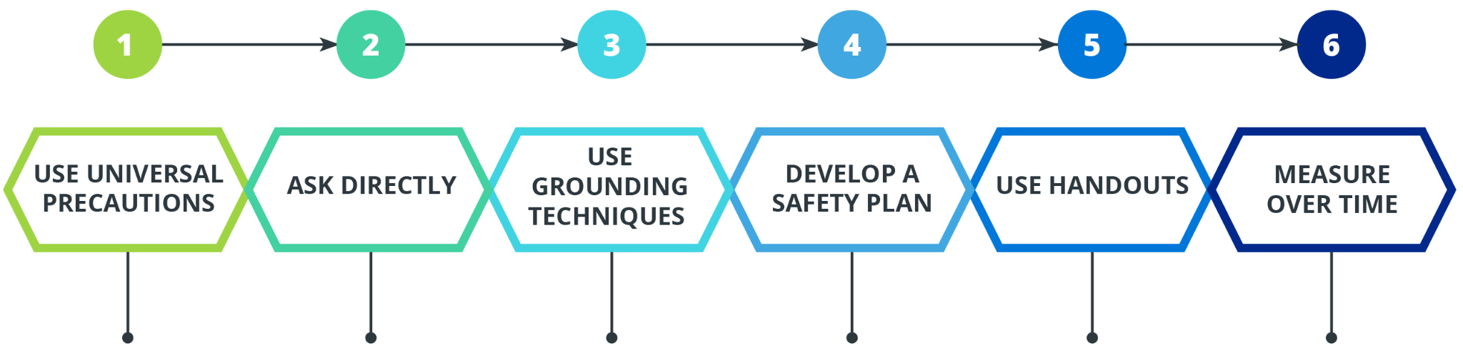
Reducing Risks: Safety is the best way forward.
Recommended Trauma Informed Intervention Process
Equal treatment; everyone protected; increase safety
with all; disclosure voluntary.
Be respectfully curious; explore underlying purpose or meaning;
notice patterns.
Use grounding to safely detach from emotional pain; become more centered in the here-and-now.
Create an agreed-upon safety plan;
if needed,
write it down—
look at it—
say it out loud—
then destroy it.
Use printed and other media to help clients practice skills outside of session.
Use objective measures to determine success (or not).

Slide 8
Escape from what?
Trauma survivors tend to be “escape” gamblers as opposed to “action” gamblers.

Slide 9
Scope of the problem: $14 billion
The national social cost of problem gambling was estimated at $14 billion in 2023, including criminal justice, healthcare, job loss, bankruptcy and other consequences.
—The National Council on Problem Gambling
Notes:
National Council on Problem Gambling. (2025). FAQs: What is Problem Gambling? https://www.ncpgambling.org/help-treatment/faqs-what-is-problem-gambling/

Slide 10
LIE/BET Tool to rule out problem gambling
Discriminates between problem and non-problem gamblers.
One “yes” response to either question warrants further assessment.
Have you ever felt the need to bet more and more money?
Have you ever had to lie to people important to you about how much you gambled?
2-item measure
Reliable and valid
(Götestam et al., 2004)
Notes:
Götestam, K. G., Johansson, A., Wenzel, H. G., & Simonsen, I. E. (2004). Validation of the lie/bet screen for pathological gambling on two normal population data sets. Psychological reports, 95(3 Pt 1), 1009–1013. https://doi.org/10.2466/pr0.95.3.1009-1013

Slide 11
Escape gambling: Warning signs
Going alone
Losing track of time
Gambling to “zone out”
Feeling worse after gambling
Becoming secretive about gambling
Spending more money than planned
Feeling anxious about being seen gambling
Staying on after family and friends have left

Slide 12

Trauma:
The roots of self-destruction
Current unsafe behaviors are best understood as largely non-conscious self-help for unrecognized trauma symptoms

Slide 13
Problem gambling prevention programs should be targeted at individuals who have experienced trauma, as they are at increased risk for the development of gambling problems.
Jennifer Zorland and Angela Mooss, 2008
Georgia State University Problem Gambling Research
and Intervention Project
Notes:
The Georgia State University Problem Gambling Research and Intervention Project website no longer exists, but it has been succeeded by the Georgia Council on Problem Gambling and is quoted in
Georgia Department of Behavioral Health & Developmental Disabilities. (2011). Violence, Trauma, and Problem Gambling. https://dbhdd.georgia.gov/document/document/trauma0911pdf/download

Slide 14

Exposures: Adverse Childhood Experiences (ACEs)
Death
Client Level:
Smallest Impact
Individualized treatment; individual behavior change
Individual
Factors
Early Death
Disease, Disability & Social Problems
Adoption of Health Risk Behavior
Social, Emotional & Cognitive Impairment
Disrupted Neurodevelopment
Intervention
Population Level: Highest Impact
Social determinants
of health;
public
action
Interpersonal
Factors
Adverse Childhood Experiences
Community
& Institutional
Factors
Social Conditions / Local Context
Prevention
Societal, Systemic
& Cultural Factors
Generational Embodiment / Historical Trauma
Conception
(Adapted from Centers for Disease Control and Prevention, 2021)
Notes:
Adapted from
Centers for Disease Control and Prevention. (2021, April 6). About the CDC-Kaiser ACE Study. https://www.cdc.gov/violenceprevention/aces/about.html
Study on whether ACEs are associated with an increased risk of premature death during adulthood (although it does not use the pyramid image):
Brown, D. W., Anda, R. F., Tiemeier, H., Felitti, V. J., Edwards, V. J., Croft, J. B., & Giles, W. H. (2009). Adverse childhood experiences and the risk of premature mortality. American journal of preventive medicine, 37(5), 389–396. DOI:10.1016/j.amepre.2009.06.021. https://pubmed.ncbi.nlm.nih.gov/19840693/

Slide 15
Diagnosing Trauma
“
Individual trauma results from exposure to an event, series of events or set of circumstances [Ex] that is experienced by an individual as physically or emotionally harmful or life threatening [Sx/Bx] and that has lasting adverse effects on the individual’s functioning and physical, social, emotional or spiritual well-being [Dx➡Tx/Rx].
SAMHSA’s Concept of Trauma and Guidance for a Trauma-Informed Approach Substance Abuse Mental Health Services Administration (SAMHSA, 2014)
“
Exposure to negative event
(Ex)
Systems of coping unavailable to individual
(Sx/Bx)
Accelerated Immuno-
senescence
(Dx➡Tx/Rx)
Notes:
Substance Abuse and Mental Health Services Administration. (2014). SAMHSA’s Concept of Trauma and Guidance for a Trauma-Informed Approach. HHS Publication No. (SMA) 14-4884. Rockville, MD: Substance Abuse and Mental Health Services Administration. https://www.nctsn.org/sites/default/files/resources/resource-guide/samhsa_trauma.pdf
No longer available on the SAMHSA website September 2025
https://library.samhsa.gov/sites/default/files/sma14-4884.pdf
According to County Health Rankings, which measures vital health factors in nearly every county in the United States, health outcomes are shaped far more by community factors, including the social, economic and physical environment, than by clinical care or personal health behaviors. (See https://www.countyhealthrankings.org/what-impacts-health )

Slide 16
Trauma Formula
Ex
Sx/Bx
Dx ➡ Tx/Rx
Notes:
Nice colors

Slide 17
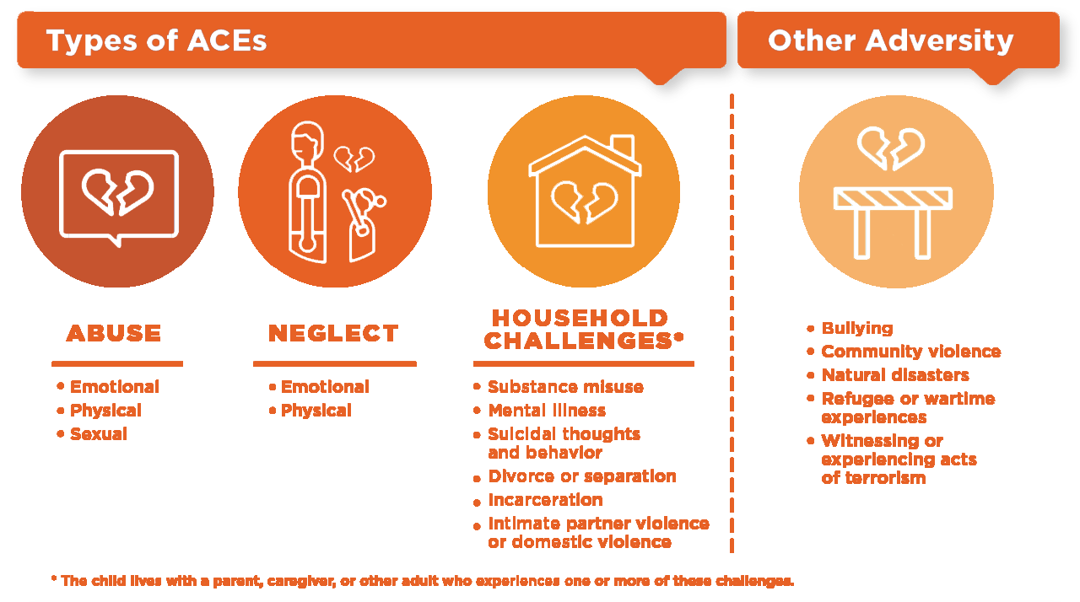
ACEs Measure Exposure
ABUSE | NEGLECT | HOUSEHOLD CHALLENGES*
Bullying Community violence Natural disasters Refugee or wartime experience Witnessing or experiencing acts or terrorism
Emotional Physical Sexual | Emotional Physical | Substance misuse Mental illness Suicidal thoughts and behavior Divorce or separation Incarceration Intimate partner violence or domestic violence
*The child lives with a parent, caregiver, or other adult who experiences one or more of these challenges.
(CDC, 2024)
Notes:
New visual used by ACEs Aware with permission from the Robert Wood Johnson Foundation - Gabby doesn’t like this version.
Switched to CDC version 6/16/25: https://www.cdc.gov/aces/media/images/Types-of-ACEs.png
Redone with our own orange colors 10/20/25: Types-of-ACEs-ColorConnvert.png
Centers for Disease Control and Prevention (CDC). (2024, May 16). Adverse Childhood Experiences: Resources; Presentation Graphics. https://www.cdc.gov/aces/communication-resources/index.html

Slide 18
Traumatic Exposures
In a study of veterans entering a VA gambling treatment program, compared to ACE Study:
  Childhood emotional trauma 64% v 11%
  Childhood physical trauma 41% v 28%
  Childhood sexual trauma 24% v 22%
(Kausch et al., 2006; compared to ACE study findings, 2010) )
Notes:
Kausch, O., Rugle, L., & Rowland, D. Y. (2006). Lifetime histories of trauma among pathological gamblers. The American journal on addictions, 15(1), 35–43. https://doi.org/10.1080/10550490500419045
============================
Trigger for genetic, learned, social and outcast causes
Scherrer, Jeffrey F. PhD*†; Xian, Hong PhD†‡; Kapp, Julie M. Krygiel PhD§; Waterman, Brian MPH∥; Shah, Kamini R. MHS†‡; Volberg, Rachel PhD¶; Eisen, Seth A. MD, MSc*†‡#. Association Between Exposure to Childhood and Lifetime Traumatic Events and Lifetime Pathological Gambling in a Twin Cohort. The Journal of Nervous and Mental Disease 195(1):p 72-78, January 2007. | DOI: 10.1097/01.nmd.0000252384.20382.e9
child abuse (relative risk [RR] = 2.31) = 131% increased risk
child neglect (RR = 5.53), = 453%
witnessing someone badly hurt or killed (RR = 2.83) = 183%
physical attack (RR = 3.39) were associated with pathological gambling. = 239%

Slide 19
Significant gender difference
In a study of treatment-seeking problem gamblers, a significant gender difference was discovered: women reported more childhood abuse than men.
(Petry et al., 2005)
Notes:
Petry, N. M., Steinberg, K. L., & Women's Problem Gambling Research Center (2005). Childhood maltreatment in male and female treatment-seeking pathological gamblers. Psychology of addictive behaviors : journal of the Society of Psychologists in Addictive Behaviors, 19(2), 226–229. https://doi.org/10.1037/0893-164X.19.2.226

Slide 20
Prevention strategies and treatment practices for female problem gamblers should take into account women’s mental health, addiction and trauma history as contributing factors in the development of problematic gambling.
Roberta Boughton & Olesya Falenchuk
Journal of Gambling Studies, 2007
Notes:
Boughton, R., & Falenchuk, O. (2007). Vulnerability and comorbidity factors of female problem gambling. Journal of gambling studies, 23(3), 323–334. https://doi.org/10.1007/s10899-007-9056-6

Slide 21
Women and PG
Female gamblers more likely, compared to male gamblers:
  African-American
  Histories of physical abuse
  Play longer sessions of play
  Fewer problems with drugs
  Fewer gambling-related arrests
  Higher rates of affective disorders
  Play lower denomination slot machines
  Retired, unemployed or outside the workforce
Women with disabilities also at greater risk for gambling problems.
(SAMHSA Advisory Committee for Women’s Services: Problem Gambling Issues May 11, 2009)
Notes:
Substance Abuse and Mental Health Services Administration (SAMHSA), Advisory Committee for Women’s Services. Problem Gambling Issues. Meeting Minutes, May 11–12, 2009. (Originally stated as SAMHSA Advisory Committee for Women’s Services: Problem Gambling Issues May 11, 2009)
The above publication is no longer online and SAMHSA has not published any of its own research identifying gender-specific gambling characteristics. The findings talked about by SAMHSA/ACWS come from peer-reviewed epidemiological studies including those on this list: References for Gambling Gender Differences

Slide 22
Unsafe behaviors
The measurement of the problem, but not the actual problem

Slide 23
Are unsafe behaviors trauma symptoms?
PTSD symptoms – DSM-5
  Risky and self destructive behaviors
Body of research
  Clear evidence over decades of research
  Most likely causal factor – population
  Universal precautions with individuals
Seeking Safety
  Effective for substance abuse,
  problem gambling, suicide, etc.
Survivor stories
Own experiences

Slide 24
Rarely Observed Order of Magnitude
An expanding body of research suggests that childhood trauma and adverse experiences can lead to a variety of negative health outcomes, including substance abuse, depressive disorders and attempted suicide among adolescents and adults.…Our estimates of the ARFs [Attributable Risk Factors] are of an order of magnitude that is rarely observed in epidemiology and public health data.
(Dube et al., 2001)
An order of magnitude is a class in a system of classification determined by ascending size, with each class being 10 times greater than the one before.
Notes:
An order of magnitude estimate is a variable of unknown value rounded to the nearest power of ten.
The Attributable Risk Factor (ARF) is an estimate of the proportion of the health problem that would not have occurred if no persons had been exposed to the risk factor being assessed (e.g., ACEs).
Dube, S. R., Anda, R. F., Felitti, V. J., Chapman, D. P., Williamson, D. F., & Giles, W. H. (2001). Childhood abuse, household dysfunction, and the risk of attempted suicide throughout the life span: findings from the Adverse Childhood Experiences Study. JAMA, 286(24), 3089–3096. https://doi.org/10.1001/jama.286.24.3089
The contribution of a risk factor to a disease or a death is quantified using the population attributable fraction (PAF). PAF is the proportional reduction in population disease or mortality that would occur if exposure to a risk factor were reduced to an alternative ideal exposure scenario (eg. no tobacco use). Many diseases are caused by multiple risk factors, and individual risk factors may interact in their impact on overall risk of disease. As a result, PAFs for individual risk factors often overlap and add up to more than 100 percent.
https://www.who.int/healthinfo/global_burden_disease/metrics_paf/en/

Slide 25
ACEs: Known negative risk factor
Smoking
Alcohol abuse
Illicit drug abuse
Teenage pregnancy
Risk of re-victimization
Poor adolescent health
Mental health disorders
Unsafe sexual behaviors
Instability of relationships
Poor performance in the workplace
(Anda, 2007)
Notes:
Anda, R. (2007). The Health and Social Impact of Growing Up With Adverse Childhood Experiences: The Human and Economic Costs of the Status Quo. https://theannainstitute.org/ACE%20folder%20for%20website/50%20Review_of_ACE_Study_with_references_summary_table_2_.pdf

Slide 26
Most Salient Environmental Risk Factor
Exposure to child maltreatment, including sexual and physical abuse and neglect, is the most salient environmental risk factor for self-injury identified to date.
(Lang & Sharma-Patel, 2011)
Notes:
Lang, C. M., & Sharma-Patel, K. (2011). The relation between childhood maltreatment and self-injury: a review of the literature on conceptualization and intervention. Trauma, violence & abuse, 12(1), 23–37. https://doi.org/10.1177/1524838010386975

Slide 27
Traumatic exposure increases risk
A twin cohort study found exposure to childhood and lifetime traumatic events are significantly associated with problem gambling and gambling disorder.
  Child neglect 453% increased risk
  Physical attack 239%
  Witnessing someone badly hurt or killed 183%
  Child abuse 131%
(Scherrer, et al. 2007)
Greater severity of childhood abuse
  earlier age of gambling onset
  more severe gambling problems
(Petry et al., 2005)
Notes:
Trigger for genetic, learned, social and outcast causes
Scherrer, J. F., Xian, H., Kapp, J. M., Waterman, B., Shah, K. R., Volberg, R., & Eisen, S. A. (2007). Association between exposure to childhood and lifetime traumatic events and lifetime pathological gambling in a twin cohort. The Journal of nervous and mental disease, 195(1), 72–78. https://doi.org/10.1097/01.nmd.0000252384.20382.e9
child abuse (relative risk [RR] = 2.31) = 131% increased risk
child neglect (RR = 5.53), = 453%
witnessing someone badly hurt or killed (RR = 2.83) = 183%
physical attack (RR = 3.39) were associated with pathological gambling. = 239%
Petry, N. M., Steinberg, K. L., & Women's Problem Gambling Research Center (2005). Childhood maltreatment in male and female treatment-seeking pathological gamblers. Psychology of addictive behaviors : journal of the Society of Psychologists in Addictive Behaviors, 19(2), 226–229. https://doi.org/10.1037/0893-164X.19.2.226

Slide 28
ACEs and Drug Abuse – CDC-Kaiser ACE Study
Source: Overview of the Adverse Childhood Experiences Study, 2013 slide presentation by Robert F. Anda, MD
Notes:
Source: Anda, R. F. (2013). Overview of the Adverse Childhood Experiences Study. [PowerPoint slides]. https://www.slideshare.net/slideshow/the-adverse-childhood-experiences-ace-study/70897330
https://docplayer.net/20889213-Overview-of-the-adverse-childhood-experiences-ace-study-robert-f-anda-md-ms-co-principal-investigator-www-robertandamd-com.html [This link doesn’t work anymore, August 2024]

Slide 29
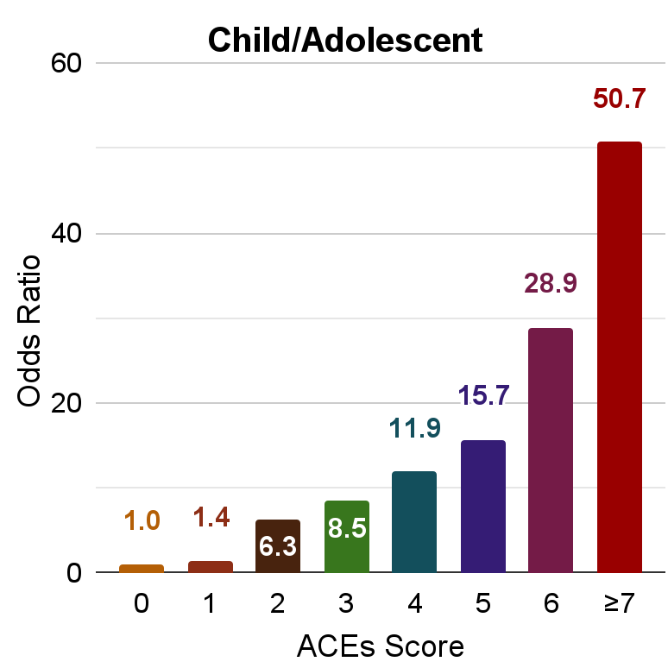
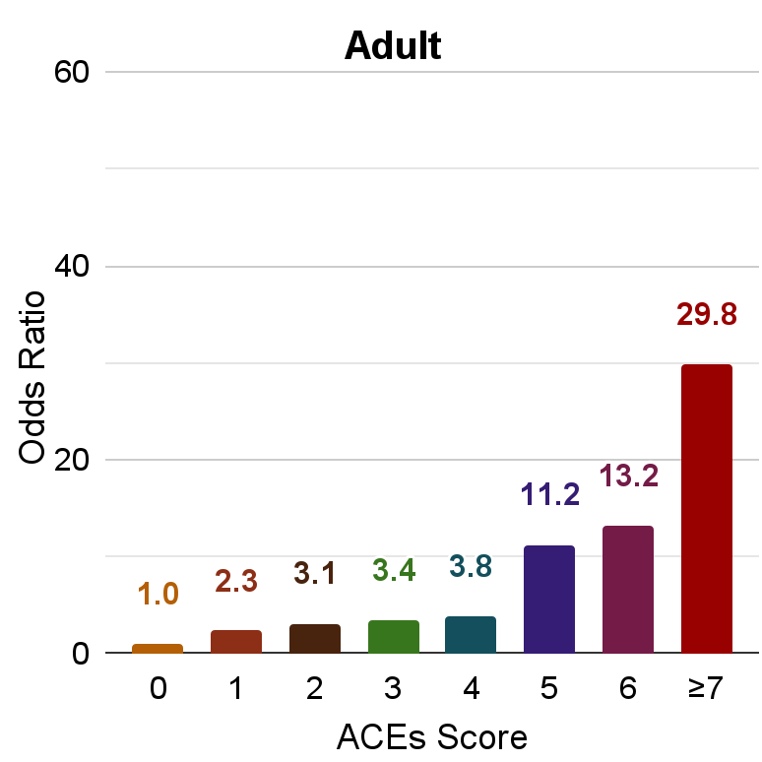
Adverse Childhood Experiences (ACEs) and Suicide Attempts
Comparison of ACEs Score to
Odds Ratio for Having Attempted Suicide
Increased Risk for Suicide Attempts by ACE Score
Child/Adolescent
1 = 40%,
2 = 530%,
3 = 750%,
4 = 1,090%
≥7 = 4,970%
Adult
1 = 130%
2 = 210%
3 = 240%
4 = 280%
≥7 = 2,880%
(Anda & Felitti, 2011;
Dube et al., 2001))
Notes:
The 17,337 participants in the CDC-Kaiser ACE Study (1998) were 74.8% White, 11.2% Hispanic, 4.5% Black, 7.2%% Asian/Pacific Islander, and 2.3% Other; 75.2% had attended some college or graduated from college; 46% were male and 545 were female (https://www.cdc.gov/violenceprevention/aces/about.html). The average study participant was 57 years old (https:/www.ncbi.nlm.nih.gov/pmc/articles/PMC6220625).
Increased Risk percentages based on Dube Table for and corrected January 8, 2024 using correct conversion formula:
Percentage Increase = (Odds Ratio - 1) x 100
The original graph on this slide was titled Childhood Experiences Underlie Suicide Attempts and was from Felitti & Anda, 2011. It didn’t have the graphed numbers on it, and we switched to using the table from Dube to make our own graph. Felitti & Anda, 2011 is left in the source note just to illustrate the historical trail.
Anda, R.F. & Felitti, V.J. (2011). Adverse Childhood Experiences and their Relationship to Adult Well-being and Disease: Turning gold into lead. A collaborative effort between Kaiser Permanente and the Centers for Disease Control. Slide presentation at the Office on Women’s Health, US Dept. of HHS, Chicago, IL, July 20, 2011. https://courts.ca.gov/sites/default/files/courts/default/2024-12/btb_xxii_vj_1.pdf
Dube, S. R., Anda, R. F., Felitti, V. J., Chapman, D. P., Williamson, D. F., & Giles, W. H. (2001). Childhood abuse, household dysfunction, and the risk of attempted suicide throughout the life span: findings from the Adverse Childhood Experiences Study. JAMA, 286(24), 3089–3096. https://doi.org/10.1001/jama.286.24.3089

Slide 30
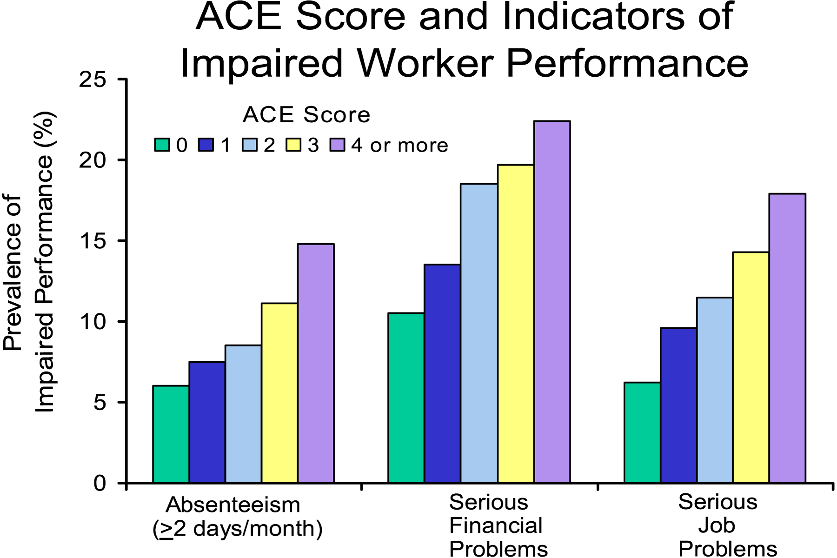
ACEs and Worker Performance (CDC-Kaiser ACE Study)
Source: Anda, R. (2007). The health and social impact of growing up with adverse childhood experiences: The human and economic costs of the status quo. Centers for Disease Control and Prevention.
Notes:
Anda, R. (2007). The health and social impact of growing up with adverse childhood experiences: The human and economic costs of the status quo. Centers for Disease Control and Prevention. https://theannainstitute.org/ACE%20folder%20for%20website/50%20Review_of_ACE_Study_with_references_summary_table_2_.pdf

Slide 31

Killer Cocktail
Multiple unacknowledged traumatic exposures
Abundant alcohol with or without other drugs
Frequent negative, intrusive thoughts
Undiagnosed or untreated PTSD
Sprinkle of insomnia
Chronic depression
Mix well
Garnish with an assortment of impulsive, unsafe behaviors

Slide 32
PTSD and Suicide
It is not trauma [exposure] but PTSD [lasting symptoms] that is an independent predictor of subsequent suicide attempt.
Dr. Holly C. Wilcox
The Johns Hopkins University School of Medicine
(Rauscher, 2009)
Notes:
Among 1,698 young adults interviewed at an average age of 21 years, 1,273 (75 percent) had been exposed to a traumatic event, but only 100 (8 percent of those exposed to trauma) developed PTSD.
The researchers calculate that trauma-exposed young adults who developed PTSD had a 2.7-fold increased risk of a later suicide attempt, after accounting for established risk factors for attempted suicide such as depression and alcohol or drug abuse.
(Dr. Wilcox quoted by Megan Rauscher in the March 5, 2009 Reuters article.)
Rauscher, M. (2009, March 5). PTSD but not trauma itself ups suicide risk. Reuters. https://www.reuters.com/article/idUSTRE5245UR20090305

Slide 33


A Range of Symptoms from Simple to Complex
C-PTSD (ICD-11) – 6 Symptoms Re-experiencing; Avoidance; Hypervigilance; Emotional dysregulation; Interpersonal difficulties; Negative self-concept | Complex Trauma (NCTSN) – 7 symptoms Attachment; Biology; Affect dysregulation; Dissociation; Behavioral regulation; Cognition; Self-concept | Developmental Trauma Disorder (van der Kolk) – 7 symptoms Dysregulation; Affective; Somatic; Behavioral; Cognitive; Relational; Self-attribution
Anger, self-destructive behavior, hypervigilance, insomnia
Biology & Somatic Dysregulation
Substance abuse, Self-harm, Behavioral
Arousal & Reactivity
Emotional & Affective Dysregulation
Self-blame, detachment, persistent diminished interests and enjoyment, amnesia
Negative cognitions & mood
Impaired self-
development, Loss of self, Worthless-
ness, Guilt
Limiting, restricting, isolation
Avoidance
Relationships, attachment, intimacy disorganization, Interpersonal difficulties
PTSD (symptoms persistence: 1 month minimum)
Many Diagnoses
(symptoms persistence: 6 months minimum)
Nightmares,
flashbacks,
re-experiencing
Intrusion
Dissociation
Singular Trauma –
exposure to adverse events in adulthood or childhood (6+) (DSM-5) – 4 symptoms
Developmental Trauma – exposure to chronic early childhood, interpersonal, intergenerational, or historical adversity
Alterations
Dysregulation

Slide 34
PTSD and problem gambling
PTSD: 13-29% among problem gamblers v. 5-6% gen pop.
34% of treatment-seeking problem gamblers had a high level of PTSD symptoms.
PTSD symptoms strongest predictor of being an "at risk" gambler in a study of 843 elderly adults (11% identified).
History of trauma among problem gamblers showed associations with
  Drug and alcohol dependence
  Greater frequency of suicide attempts
  More severe scores in measures of psychiatric distress
(Kausch et al., 2006; Ledgerwood & Petry, 2006; Levens et al., 2005)
Notes:
Ledgerwood, D. M., & Petry, N. M. (2006). Posttraumatic Stress Disorder Symptoms in Treatment-Seeking Pathological Gamblers. Journal of Traumatic Stress, 19(3), 411–416. https://doi.org/10.1002/jts.20123
Levens, S., Dyer, A.M., Zubritsky, C., Knott, K., & Oslin, D.W. (2005). Gambling among older, primary-care patients: An important public health concern. American Journal of Geriatric Psychiatry 13(1): 69–76.
=====================
Narrow WE, Rae DS, Robins LN, Regier DA. Revised prevalence estimates of mental disorders in the United States: using a clinical significance criterion to reconcile 2 surveys' estimates. Arch Gen Psychiatry 2002;59:115-123. [Free Full Text]
Kausch, O., Rugle, L., & Rowland, D. Y. (2006). Lifetime histories of trauma among pathological gamblers. The American journal on addictions, 15(1), 35–43. https://doi.org/10.1080/10550490500419045

Slide 35
Co-occurring PTSD and gambling disorder
In a study, 17% of military veterans entering treatment for PTSD met criteria for gambling disorder.
Co-occurring PTSD and gambling disorder:
  Greater impulsivity
  Greater disorder severity
  Worse overall functioning
  Greater lifetime gambling severity
  Greater psychiatric symptom severity
  Greater dissociation in high- versus low-PTSD subjects.
(Biddle et al., 2005; Ledgerwood and Petry, 2006)
Notes:
Biddle, D., Hawthorne, G., Forbes, D., & Coman, G. (2005). Problem gambling in Australian PTSD treatment-seeking veterans. Journal of traumatic stress, 18(6), 759–767. DOI:10.1002/jts.20084. https://2024.sci-hub.box/166/4ae5b22c62a5f86ca6721f47f2735447/biddle2005.pdf

Slide 36
Thought experiment
What aspects of gambling would a person with PTSD find
Safe?
Relaxing?
Familiar?
Upsetting?

Slide 37
Break!

Slide 38
Financially risky behaviors
Almost all unsafe behaviors are costly, in the short and long run

Slide 39
“
Gambling disorder involves excessively placing something of value on an event of uncertain outcomes in the hopes of winning or earning a larger reward.
Activities such as playing the financial markets and sports betting show cognitive, motivational and personality parallels between gamblers and stock traders.
Timothy Fong, M.D.
Gambling Studies Program
UCLA Gambling Studies Program
Department of Psychiatry and Biobehavioral Sciences
(Schlossberg, 2021)
“
Notes:
Schlossberg, J. A. (2021, February 23). How the impulses behind gambling disorder parallel investing addiction. UCLA Health. https://www.uclahealth.org/news/article/how-the-impulses-behind-gambling-disorder-parallel-investing-addiction

Slide 40
Financially risky behaviors – Red flags
(Adapted in part from Boughton & Falenchuk, 2007)
Regular cigarette smoking*
Eating disturbances, particularly binge eating*
Engaged in occasional spending sprees
Involved in get rich quick schemes
Invested in flaky business schemes
Hot investment leads, day trading
Imprudent use of credit cards
Occasional use of pawn shops for money
Payday lenders as primary financial agent
Multiple late fees/returned check fees per year
Investment in pyramid schemes
Unable to qualify for a checking account
Makes impulse purchases from the TV
Owns things to fix up and sell that pile up
Has sent money through chain letters
Daily or frequent use of lottery
Multiple store credit cards with balances
Gambling as a Plan B to be able to pay bills
Loss of relationships due to non-payment of debt
Has asked employer for an advance
Has a no sense of where the money went
Flashy dressing and cars bought on credit
Unpaid student loans for an unfinished degree
Identifies “retail therapy” with problem-solving
No savings or retirement plan
Poor understanding of basic financial concepts (interest, accrual, principal, balance)
Has never balanced a checkbook
Internet-based gambling, sports betting
High-risk investing, crypto, day-trading
Notes:
These are on the basis of the 2007 study reported in Boughton, R., & Falenchuk, O. (2007). Vulnerability and comorbidity factors of female problem gambling. Journal of gambling studies, 23(3), 323–334. https://doi.org/10.1007/s10899-007-9056-6

Slide 41
In addition to problematic gambling, many respondents reported concurrent and past struggles with multiple problematic behaviors, most frequently identifying smoking, binge eating and compulsive shopping as issues.
(Boughton & Falenchuk, 2007)
Notes:
Boughton, R., & Falenchuk, O. (2007). Vulnerability and comorbidity factors of female problem gambling. Journal of gambling studies, 23(3), 323–334. https://doi.org/10.1007/s10899-007-9056-6

Slide 42
Voluntary Exercise – 15 min
Safe coping list
  Find 5 safe coping skills inside risky financial behaviors.
    Be specific!

Slide 43
Trauma-informed services
Trauma + Information = Transformation

Slide 44
TIP 57: SAMHSA’s trauma-informed framework
Trauma-specific: services whose primary task is to address the impact of trauma and to facilitate trauma recovery
Trauma-informed: create a milieu that acknowledges the impact of trauma and attempts to create a sense of safety

Slide 45
Benefits: trauma-informed services
Cost-effective
Responsive to real needs
Evidence-based and effective
Highlights glitches in systems
Aligned with overarching goals
Works with other best practices
Offers humane and ethical solutions

Slide 46
The trauma informed staff person’s toolbox
Trauma theory and evidence-based practices
  Theory: e.g., Harris and Fallot
  Manual: e.g., Seeking Safety (WCDVS)
  Model: e.g., Institute for Health and Recovery
Motivational interviewing
Strengths-based advocacy
Effective program design and P&P

Slide 47
What is financial literacy?
The ability to effectively evaluate and manage one’s finances in order to make prudent decisions toward reaching life goals and achieve financial well-being.
Being financially literate helps to protect individuals from being exploited through identity fraud or questionable investments and allows them to meet basic, everyday needs. (AIPCA)
Mymoney.gov -- free toolkit https://www.mymoney.gov/mymoney-five-tools
Dollars & Sense workshop CalCPA https://www.calcpa.org/get-involved/community-outreach

Slide 48
Is my client financially literate?
Adults with histories of child abuse and neglect may have never learned basic financial literacy skills.
Victims of partner abuse may have been deprived of even basic financial decision-making power.
Key ally – CALCPA https://www.calcpa.org/get-involved/community-outreach
Key resource – mymoney.gov https://www.mymoney.gov/mymoney-five-tools
Notes:
http://www.dss.cahwnet.gov/Forms/English/SOC341.pdf
Link for California form SOC 341 (2/24): https://cdss.ca.gov/MandatedReporting/story_content/external_files/SOC341.pdf
Form SOC 341 is “Report of Suspected Dependent Adult/Elder Abuse”
“REPORTING PARTY DEFINITIONS Mandated Reporters (WIC Section 15630 (a)) Any person who has assumed full or intermittent responsibility for care or custody of an elder or dependent adult, whether or not that person receives compensation, including administrators, supervisors, and any licensed staff of a public or private facility that provides care or services for elder or dependent adults, or any elder or dependent adult care custodian, health practitioner, clergy member, or employee of a county adult protective services agency or a local law enforcement agency, is a mandated reporter."

Slide 49
What is financial abuse?
Financial abuse is perpetrated by another person. Financial predators target the elders and dependent adults.
Scams, such as foreign lotteries, the sale of costly and ineffective annuities, and fraudulent home repairs, are prevalent.
County-based Financial abuse specialist teams (FAST) in many counties
Caseworkers in adult protective services actually work with a higher proportion of elder self-neglect cases than any other of the case categories subsumed under elder mistreatment.
Notes:
http://www.cwda.org/downloads/publications/adult/ditl_report2.pdf
[The above link doesn’t work anymore]
California Welfare Directors’ Association

Slide 50
Is my client financially abused?
Financial abuse of the mentally ill is common, even among the destitute
Mandated reporting for financial abuse for elders and dependent adults, including people in a residential facility
Adult protective services – key ally
Senior citizen and mental health advocates – key ally

Slide 51
What is financial self-neglect?
Financial self-neglect results from the inability of an elder or dependent adult to manage his/her own financial affairs.
It is a part of the larger “self-neglect” category:
  the result of an adult's (usually defined as 18 or older) inability, due to physical and/or mental impairments or a diminished capacity, to perform essential self-care tasks, including providing essential food, clothing, shelter, and medical care; obtaining goods and services necessary to maintain physical health, mental health, emotional well-being, and general safety; and/or managing financial affairs.
(NAPSA, 2026)
Nationwide, 50% or more of the cases annually referred for possible adult protective services intervention are elder self-neglect. (NAPSA fact sheet)
In California in FY 2024–25,
  Reported cases of financial self-neglect equaled
    22,111 cases
  Financial abuse perpetrated by others equaled
    28,824 cases
(Treggiari, 2025)
Notes:
NAPSA. (2026). Neglect & Self-Neglect. https://www.napsa-now.org/neglect-and-self-neglect/
NAPSA. (n.d.) Self-neglect and APS: A national perspective [Fact sheet]. National Adult Protective Services Association.
Treggiari, J. (2025, September 24). Subject: Adult Protective Services Response to Financial Scams [Letter to Chair Nava and Little Hoover Commission Members]. California Department of Social Services. https://lhc.ca.gov/wp-content/uploads/DSS-Little-Hoover-Commission-APS-Final.pdf

Slide 52
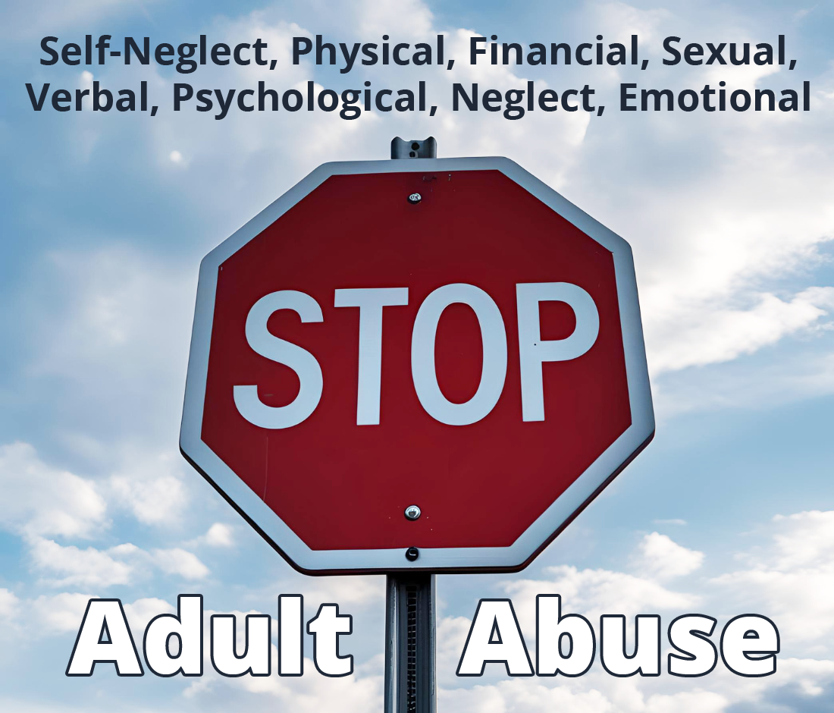
Report Suspected Adult Abuse
Each year, many older adults and younger adults who are incapacitated are victims of mistreatment by family members, by caregivers and by others responsible for their well-being.

Slide 53
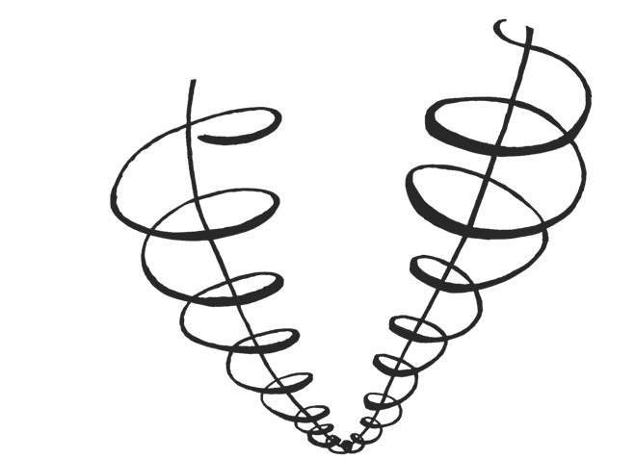
The Upward Spiral (Covington)
Transformation
Source: (Covington, 1999)
Trauma/Addiction
(constriction)
Recovery
(expansion)
Notes:
Covington, S. (1999). Helping Women Recover: A Program for Treating Addiction. Jossey-Bass. https://www.stephaniecovington.com/books/bookstore/helping-women-recover-a-program-for-treating-addiction-criminal-justice/
This graphic is also reprinted in this PDF essay: https://www.stephaniecovington.com/site/assets/files/1537/5.pdf

Slide 54
Reducing Risks: Safety is the best way forward.
Recommended Trauma Informed Intervention Process
Equal treatment; everyone protected; increase safety
with all; disclosure voluntary.
Be respectfully curious; explore underlying purpose or meaning;
notice patterns.
Use grounding to safely detach from emotional pain; become more centered in the here-and-now.
Create an agreed-upon safety plan;
if needed,
write it down—
look at it—
say it out loud—
then destroy it.
Use printed and other media to help clients practice skills outside of session.
Use objective measures to determine success (or not).

Slide 55
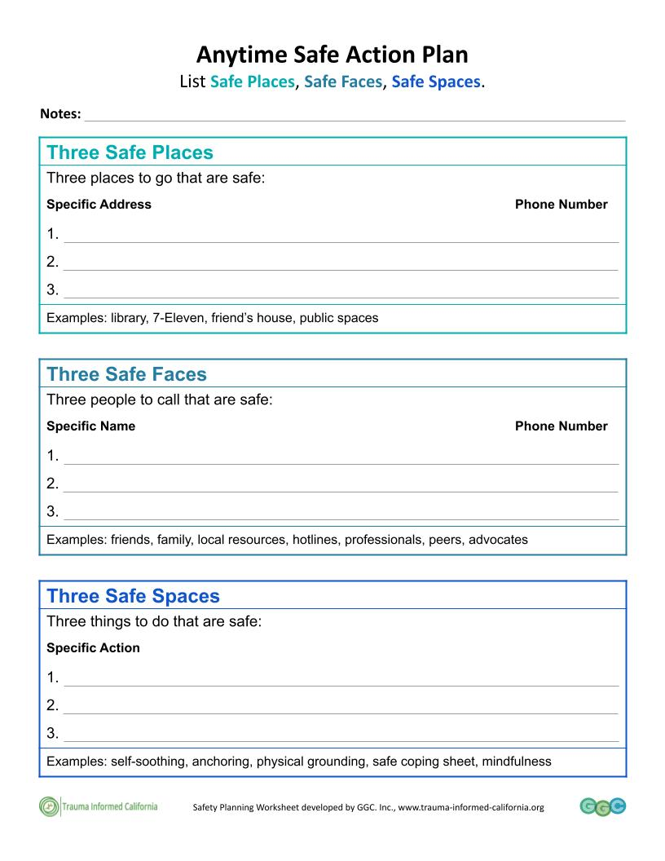
Planning for the trigger/danger
Anytime
Safe Action Plan
Worksheet
Safe Places
Safe Faces
Safe Spaces

Slide 56
Stages of Trauma Recovery by J. Herman
THREE GROUP MODELS
Group | Stage of Recovery
 | One | Two | Three
Therapeutic task | Safety | Remembrance and mourning | Reconnection
Time Orientation | Present | Past | Present, future
Focus | Self-care | Trauma | Interpersonal
Membership | Homogeneous | Homogeneous | Heterogeneous
Boundaries | Flexible, inclusive | Closed | Stable, slow turnover
Cohesion | Moderate | Very high | High
Conflict tolerance | Low | Low | High
Time limit | Open-ended or repeating | Fixed limit | Open-ended
Structure | Didactic | Goal-directed | Unstructured
Example Dr Najavits Curriculum | Twelve-step program Seeking Safety | Survivor group Creating Change | Interpersonal therapy group Facing Forward
(Herman, J., 1997, Trauma and Recovery: The aftermath of violence – from domestic abuse to political terror, p. 218)
Notes:
Herman, J. (1997). Trauma and recovery: The aftermath of violence – from domestic abuse to political terror. New York, NY: Basic Books.

Slide 57
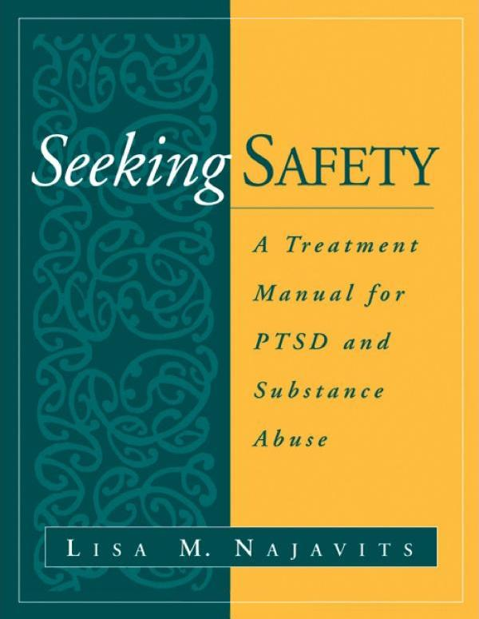
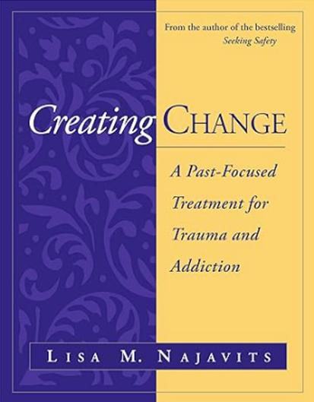
Treatment Recommendation: Seeking Safety
Manualized treatment for PTSD and SUD + other unsafe behaviors
Evidence-based, effective, safe and low-cost
In several languages and formats
Present-focused, promotes changes related to unsafe behavior
Follows Dr. J. Herman’s Stages of Trauma Recovery
New treatment available: Creating Change
Learn more: https://www.treatment-innovations.org/

Slide 59
4 Dimensions of trauma-informed care
Self-care
Consumer and staff (direct [customer] services)
Structure and design (program)
System interaction (policy/advocacy)

