Slide 1

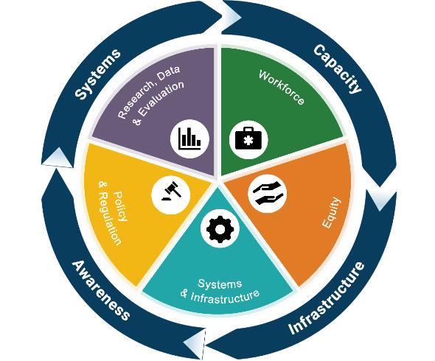


Building Stronger Systems: Assessing and Improving State and Community Problem Gambling Infrastructure
Chuck Klevgaard
Education Development Center
T. Schweimler
OMNI Institute

Slide 2



Who We Are
Eden Griffin, Ph.D.
Chuck Klevgaard, CSPS
T Schweimler, MA
Omni Institute
Director
Education Development Center
Senior Project Director for Prevention Technology
Omni Institute
Research Manager

Slide 3
Welcome Message
“"Public health decision making can be a complicated process due to the complex nature of its inputs and the need for group consensus. Nevertheless, public health research and practice over the last century has achieved remarkable milestones, contributing to a 30-year gain in life expectancy. These accomplishments demonstrate the power of evidence-based approaches — ones that prioritize rigorous data, systematic research, and population-level thinking. Applying this same evidence-based public health (EBPH) framework to problem gambling offers a promising path forward, shifting the focus from individual blame toward the broader social, environmental, and structural factors that drive gambling-related harm."”
T Schweimler and Chuck Klevgaard

Slide 4


HOW WE GOT HERE
OUR JOURNEY
OUR SOLUION
Listening to Diverse Partners
To better understand how problem gambling manifests in different ways around the country, EDC and OMNI listened to state administrators, council directors,, industry leaders, clinicians, prevention specialists, epidemiologists, researchers and more.
A Public Health Response
The fast-evolving problem gambling crisis requires a nimble response. State and community leaders need a strategic decision support tool to quickly determine priorities to mount a robust problem gambling infrastructure for service provision across the continuum of care.

Slide 5
The Current Landscape
YOUR TITLE HERE
State to state approaches to public health, behavioral health, and gambling vary widely..
STARK DIFFERENCES IN PUBLIC HEALTH
Public health approaches vary significantly by state due to decentralized governance, political, and economic factors. While the federal government provides guidance, states hold primary responsibility for public health, resulting in stark differences in policies, funding, and health outcomes.
Source: KFF
IMPACT ON OUTCOME
The variation in state approaches directly correlates with health outcomes, with states that heavily invest in public health, such as Massachusetts, Hawaii, and Rhode Island, consistently ranking at the top for access, prevention, and overall population health.
Source: 2025 Scorecard on State Health System Performance
GAMBLING SERVICES
As of 2023, 43 states have publicly funded programs for problem gambling services, with 8 states not allocating funds for this purpose. The funding levels vary significantly, with some states increasing their allocations and others maintaining or decreasing their spending on problem gambling prevention and treatment.
Source: NAADGS
Notes:
The Response
Most U.S. states are actively investing in gambling prevention, treatment, and research infrastructure, often funded by tax revenue from the rapid expansion of legal sports betting and online casinos. These investments are increasingly focusing on creating public health systems to address gambling addiction.
Allocations to problem gambling services continues to grow, both in total dollars and number of states providing funding

Slide 6

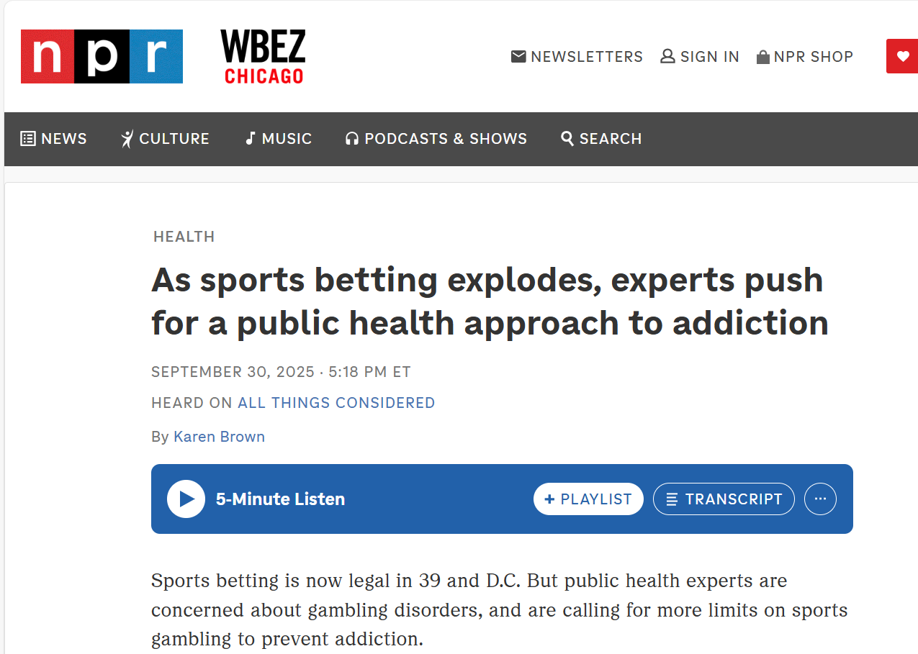
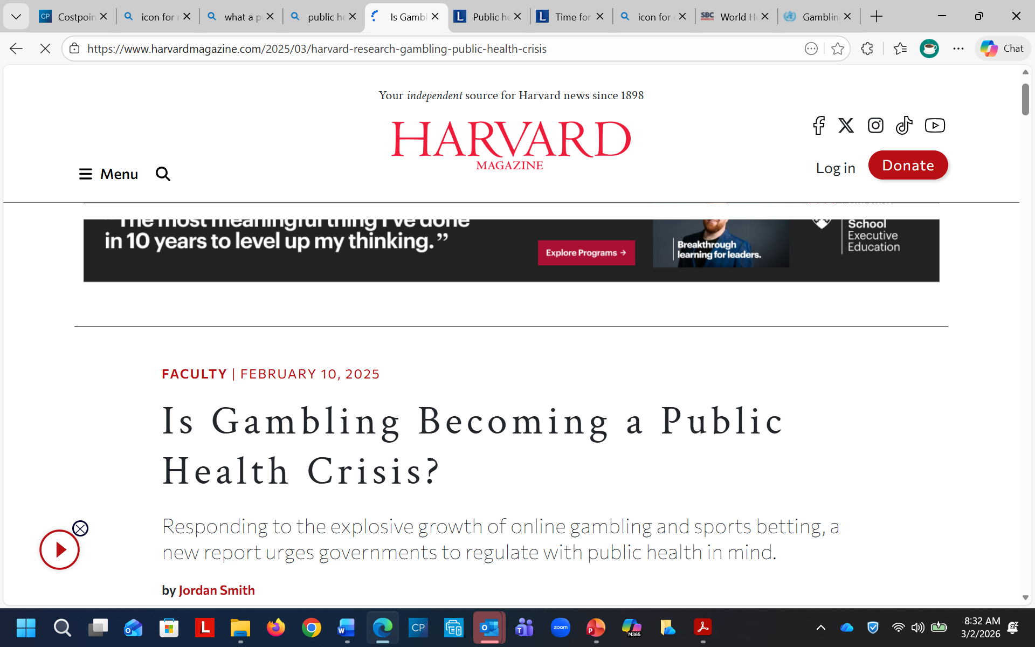
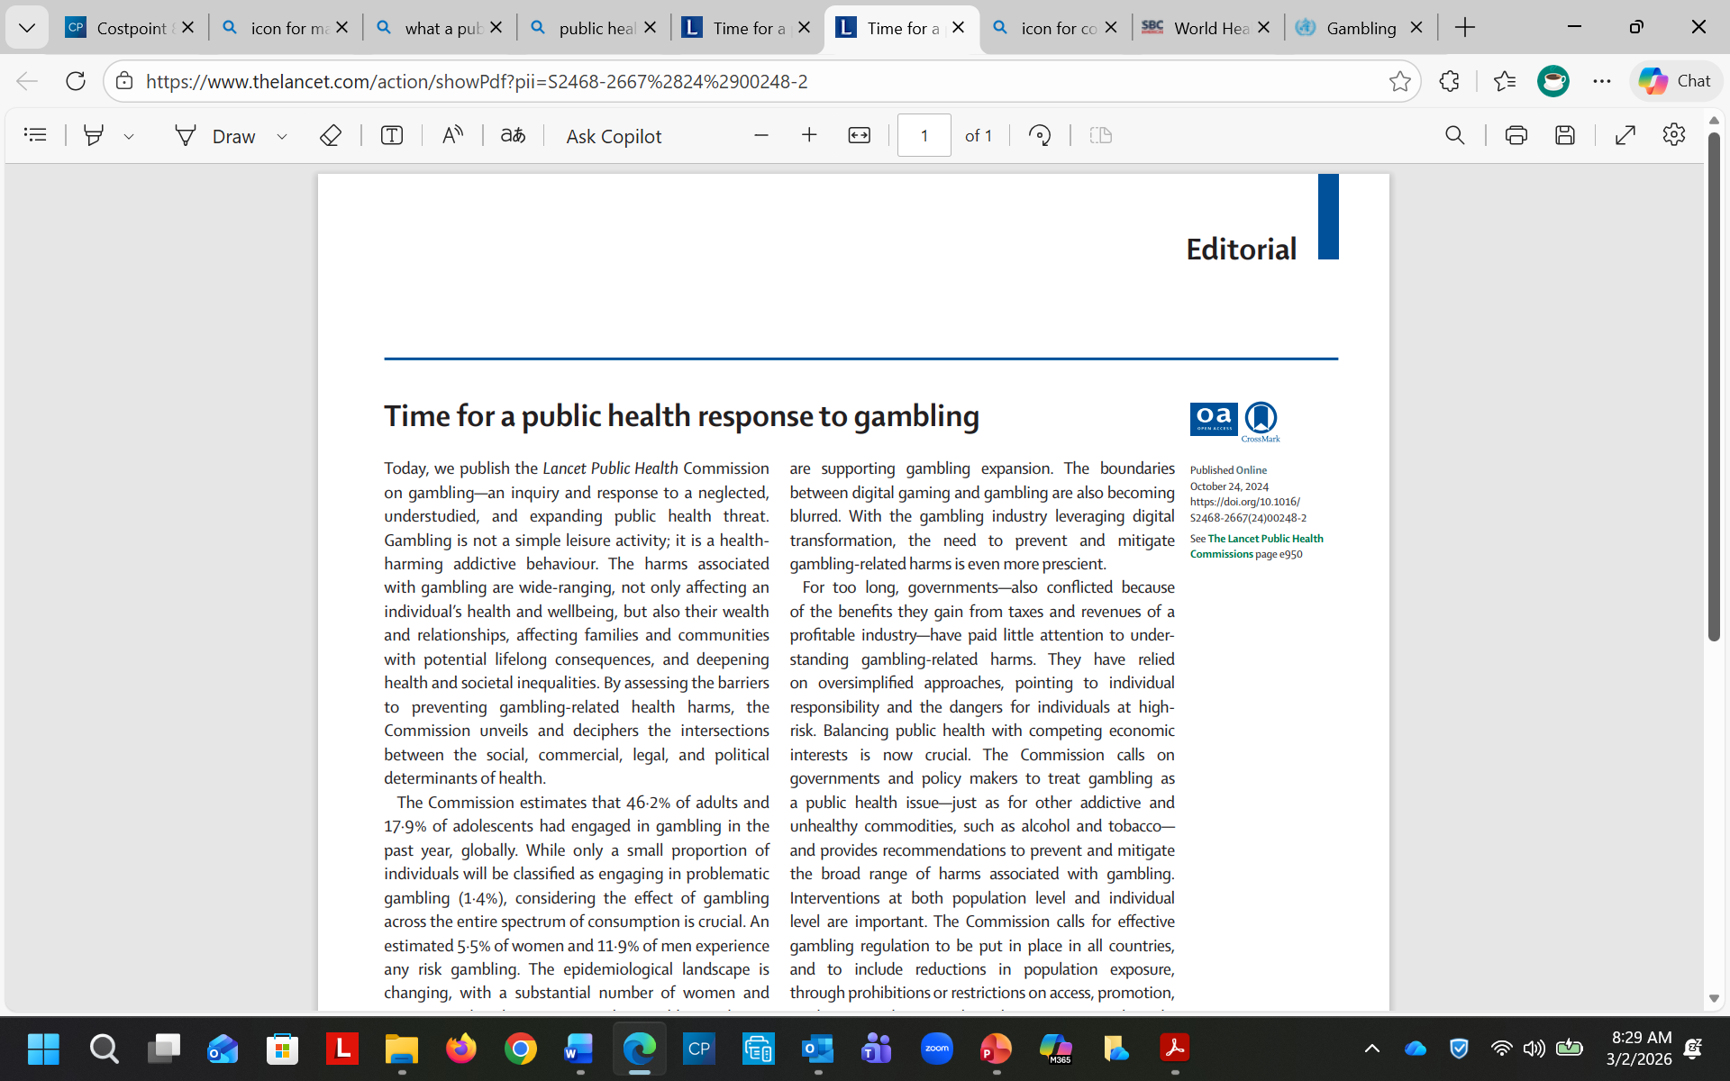

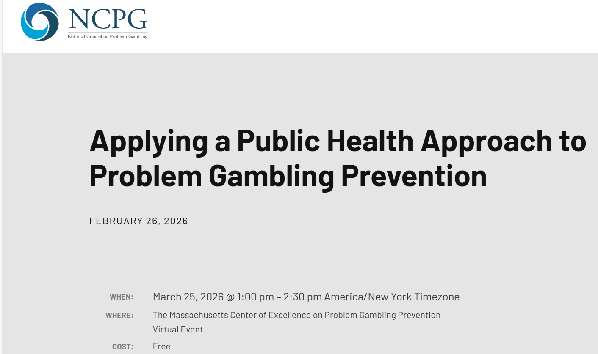
Public Health Crisis
Who is calling for this response?
What About Where You Are ?
How is this conversation changing
6
Notes:
Fact Sheet: How Investing in Public Health Will Strengthen America’s Health - Center for American Progress
https://www.americanprogress.org/article/fact-sheet-how-investing-in-public-health-will-strengthen-americas-health/#:~:text=The%20federal%2C%20state%2C%20and%20local,that%20protect%20against%20infectious%20diseases.
A public health crisis is a significant, often sudden event or threat that causes widespread illness, injury, or death, overwhelming normal health systems and requiring urgent, coordinated action. These crises can result from infectious diseases (pandemics), natural disasters, environmental hazards, or man-made incidents like bioterrorism.
Key Aspects of a Public Health Crisis: Widespread Impact:
Affects a large number of people within a community, region, or globally
Overwhelmed Systems: Strains or exceeds existing medical, social, or governmental resources.
Urgent Response: Requires immediate, coordinated intervention from authorities to protect public safety.
WHO Gambling https://www.who.int/news-room/fact-sheets/detail/gambling

Slide 7
OUR CURRENT WORK
YOUR TITLE HERE
How EDC and OMNI work with states and communities to address gambling-related harms
EDC
Omni
SHARED
Notes:
EDC currently houses the Massachusetts Center for Excellence for Problem Gambling Prevention and Healthcare Alternative Systems in Chicago to support outreach worker training.
Omni provides evaluation and technical support for Virginia’s Department of Behavioral Health and Developmental Services, including problem gambling media campaign and youth educational curriculum development, analysis and reporting for treatment and recovery reimbursement processes, needs assessment and strategic planning to integrate problem gambling into statewide behavioral health frameworks, and providing ongoing support to Virginia’s Problem Gambling Treatment and Support Advisory Committee. Omni has support the City of Medford, Massachusetts Health Department in conducting a young adult problem gambling needs assessment and facilitated development of a strategic plan for address problem gambling among youth and young adults. Omni also works with the National Council on Problem Gambling, providing analytic and reporting support for the National Problem Gambling Helpline.
EDC and Omni also work collaboratively and are currently supporting the Kentucky Department for Behavioral Health, Developmental & Intellectual Disabilities on a variety of efforts, including strategic planning, workforce development, and awareness campaign development related to problem gambling.

Slide 8

What We Are Finding
4
EVOLVING LEGISLATION
5
1
ECONOMIC INTERESTS
NO RULEBOOK
2
VARIED AWARENESS AND RESPONSE
6
COMPLEXITY OF THE ISSUES
3
UNCLEAR ROLES AND RESPONSIBLITIES
Many states are developing comprehensive approaches and multi-year strategic plans
Notes:
Lack of Accountability: If there are no clear standards or expectations, it becomes very difficult to hold anyone accountable for their actions or performance. When responsibilities are vague, it's easy for individuals to deflect blame, leading to a decline in quality and commitment.
In essence, a clear rulebook provides structure, predictability, and a common understanding—its absence creates chaos and undermines the ability to function effectively.
POLITICAL LANDSCAPE
AT the moment, the politics of gambling is driving rapid expansion through lobbying and revenue dependency, transforming governments from regulators into promoters of gaming. Politics shape policy by balancing promises of economic development (tax revenue, jobs) against social costs (addiction, crime), often favoring industry interests and normalizing "responsible gambling" as a solution.
Key Impacts of Gambling Politics
Policy Transformation: Governments, once regulators, become promoters, often prioritizing revenue over public health.
Economic Interest vs. Social Cost: Proponents emphasize jobs and tourism, while opponents highlight social impacts, such as pathological gambling and crime.
Legislative Expansion: Legalized gambling expands due to competitive pressures between states seeking revenue, rather than long-term planning.
Industry Influence: Corporate lobbying can shape regulations, particularly in the UK and US, often resulting in lenient, industry-friendly, or "liberalized" frameworks.
Public Health Shifts: Advocacy groups are increasingly pushing governments to address gambling harms as a public health issue rather than an individual failure.
Rockefeller Institute of Government
The gambling crisis is being addressed through a multi-sectoral approach involving government, health, industry, and community organizations, focusing on regulation, treatment, and prevention. Efforts include implementing stricter advertising bans, mandatory self-exclusion tools, and improving public health surveillance to combat rising addiction rates.

Slide 9

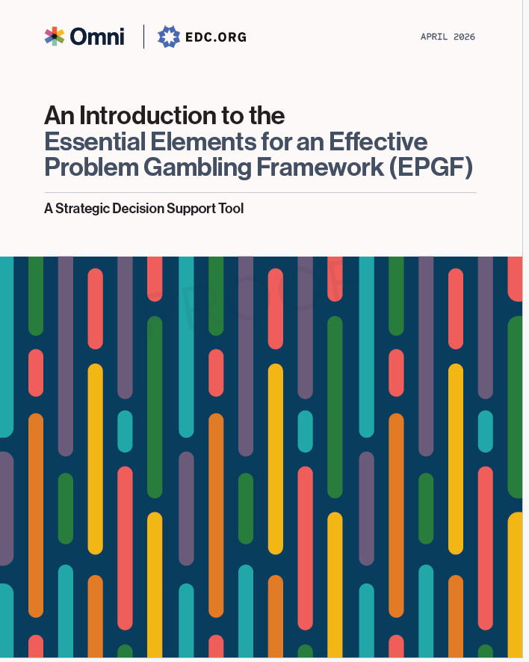
The (EPGF) Tool
The EPGF provides a strategic roadmap to address problem gambling as a public health issue through a coordinated, evidence-informed, and equity-centered approach. ​
It emphasizes
the importance of building sustainable systems, engaging diverse stakeholders, and using data to drive continuous improvement.

Slide 10
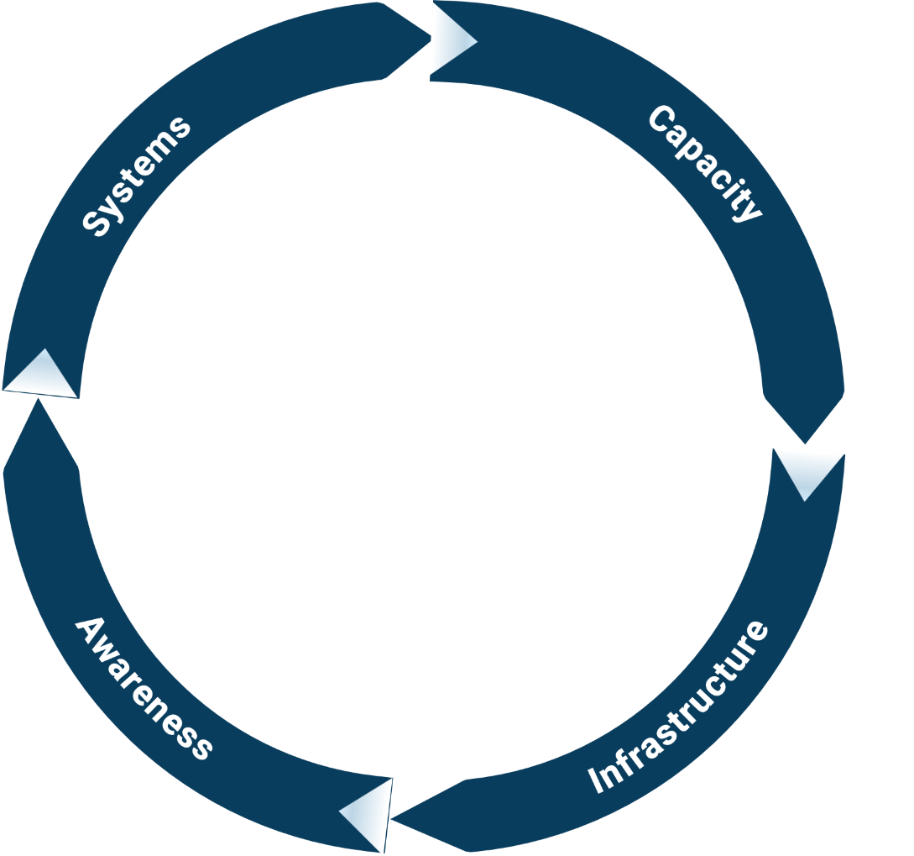
Four
Areas
The approach is organized into four areas, including: Systems, Capcity, Awareness and Infrastructure.
Five Domains
This tool is divided into five key domains that help shape a public health approach: workforce, equity, systems & infrastructure, policy & regulation, data & evaluation.
Research, Data
Workforce
& Evaluation
Policy
Equity
& Regulation
Systems
& Infrastructure

Slide 11

The current gambling
workforce is facing a severe shortage and urgent need for expansion, struggling to keep pace with the rapid rise of legalized online gambling and nearly 20 million U.S. adults reporting problem gambling behaviors.
While demand increases,
the workforce heavily underserved.
WORKFORCE ISSUES
STRATEGY NEEDED
There is a need for a national strategy to promote behavioral health workforce development, especially for gambling prevention and addiction.
INTEGRATION OF CARE
Expanding integrated care and leveraging health support workers, as well as using tele-behavioral health, may help alleviate the shortage of behavioral health providers.
LACK OF SPECIALIZED WORKERS
The lack of specialized workforce development initiatives for gambling has led to a workforce that is not equipped to respond to the growing demand for help.
Notes:
The current gambling treatment workforce is facing a severe shortage and urgent need for expansion, struggling to keep pace with the rapid rise of legalized online gambling and nearly 20 million U.S. adults reporting problem gambling behaviors. While demand increases, the workforce is heavily underserved; for example, Minnesota has only 8 certified counselors for 250,000 at-risk residents.
The U.S. is facing a deepening mental and behavioral health crisis, with gambling addiction often left out of the conversation. Despite the rising rates of gambling disorder, the mental and behavioral health workforce is already stretched thin, with one mental health provider for every 350 people. This workforce crisis is compounded by the increasing prevalence of gambling addiction, which is now as close as your smartphone. The lack of specialized workforce development initiatives for gambling has led to a workforce that is not equipped to respond to the growing demand for help.
The current gambling treatment workforce is facing significant challenges due to the increasing demand for services and the limited availability of professionals. Here are some key points regarding the current state of the gambling treatment workforce:
Mental Health Shortages: The U.S. is experiencing a mental health crisis, with over half of the population living in areas with a mental health shortage designation. This includes a shortage of professionals specifically trained to address gambling addiction.
Workforce Development: There is a need for a national strategy to promote behavioral health workforce development, especially for gambling addiction. This includes training and education programs for behavioral healthcare workers to adapt their skills to gambling.
Integration of Care: Expanding integrated care and leveraging health support workers, as well as using tele-behavioral health, may help alleviate the shortage of behavioral health providers.
Treatment Infrastructure: The treatment infrastructure for gambling addiction is behind the pace of the online gambling expansion. There is a growing need for specialized clinicians to address the unique challenges of gambling addiction treatment.
Lack of Specialized Workers
The current workforce is stretched thin, and there is a pressing need for more professionals to address the growing demand for gambling addiction treatment services.
Key initiatives include scaling up specialized training for clinicians, incorporating peer support specialists, and developing counselor certification programs to address the growing demand.
Gambling-related workforce expansion often focuses on training and education experiences for the existing behavioral health workforce. Although providing such expansion opportunities is a natural first step in workforce development, there is a need to think creatively about coordinated gambling care workforce development across multiple levels of experience and responsibility.
Developing training and education programs for behavioral healthcare workers to apply and adapt their skills from one area (e.g., substance use disorder) to gambling is an important piece of transforming the workforce landscape, but probably insufficient for truly transformative change.

Slide 12
Workforce
A well-prepared, diverse, and skilled workforce is the cornerstone of an effective state response to problem gambling.
These elements are focused on an assessment of the types of workers that are required and the competencies they need. It promotes cross-sector involvement in solutions. The focus is on building workforce development and training that is accessible, affordable, to those that need it while providing incentives and credentials.
Workforce
Key Elements of a Gambling Workforce
Capacity & Coverage
Competencies and Skills
Integrated Systems of Care
Workforce Pathways
Sustainability
Continuous Program Improvement
Cultural Responsiveness & Equity

Slide 13

Examples of Measures
Questions
We provide targeted funding for organizations implementing problem gambling prevention strategies.
We have a workforce of clinicians trained to provide treatment for problem gambling disorders.
We have standards for credentials for professionals trained in problem gambling treatment.
K-12 staff receive training on problem gambling risk and protective factors and related mental and behavioral health outcomes.
Helpline staff are trained in problem gambling.

Slide 14

The "lack of gambling data" is a critical issue currently being addressed by researchers and public health officials as legalized online and sports betting expand rapidly. While revenue figures are meticulously tracked by states and the industry, data regarding the social, health, and psychological impacts of gambling remains fragmented and under -reported compared to
other public health
crises.
Research, Data, and Evaluation
RESEARCH
While there is a growing body of research on gambling, experts highlight a significant lack of comprehensive public health data compared to other addictive substances like alcohol or tobacco.
DATA GAPS
Gaps in data make it difficult for researchers and policymakers to fully understand the impact of gambling as well as the recent surge in online and sports betting
EVALUATION
There is a pressing need for more rigorously evaluated gambling interventions, particularly regarding local, targeted prevention strategies, the impact of policy and specialized interventions to reach risk demographics.
Notes:
Key Areas Requiring Further Evaluation
Local Policies & Prevention: There is limited investigation into the effectiveness of community-level, local policy interventions compared to national approaches.
Digital and Online Interventions: With the rise of online sports betting and 24/7 access, immediate evaluation of digital, app-based, and remote interventions is necessary.
Personalized Feedback Interventions (PFIs): While promising, PFIs for gambling problems have limited peer-reviewed studies assessing their long-term effectiveness, necessitating further research on their clinical appropriateness.
Targeted Demographic Strategies: Research shows specialized interventions are needed for high-risk demographics, including young men (18–34).
Guided Self-Help Approaches: Studies show varied outcomes for self-help workbooks, with limited, mixed evidence on whether phone-based, guided support enhances effectiveness.
PubMed Central (PMC) (.gov) +6
Benefits of Evaluation
Better Treatment Tailoring: More studies can identify which interventions work best for specific types of gamblers.
Evidence-Based Policies: Evidence-based criteria are needed for both national and local prevention to ensure that public health measures, such as screening tools, are actually reducing harm.
PubMed Central (PMC) (.gov) +4
Current Evidence Gaps
Lack of Long-Term Follow-up: Many studies lack long-term follow-up data to assess whether improvements in gambling behavior remain stable.
Need for Comparative Studies: There is a need for more comparative studies between different types of interventions to determine the most effective methods, as no single approach has shown consistent, superior benefits in all contexts.
PubMed Central (PMC) (.gov) +3

Slide 15
Research, Data & Evaluation
Data-driven decision-making is essential at every stage of building and sustaining an effective problem gambling response. These elements examine a state’s capacity to collect, analyze, and apply data from surveillance and needs assessment to program monitoring,
equity tracking, and continuous quality improvement.
Research, Data & Evaluation
Key Elements of Research, Date & Evaluation
Comprehensive Data Collection
Equity-Aligned Analyses
Data Informed Decision Making
Outcome Monitoring
Capacity Building
Data Sharing and Tranparency
Notes:
Comprehensive Data Collection Gathering data on gambling behaviors, service utilization, risk and protective factors, and community needs from diverse sources (e.g., statewide surveys, treatment admissions, helpline call data).
Equity-Aligned Data Analysis Disaggregating data by race, ethnicity, geography, gender, and other relevant demographics to monitor disparities and inform equity-focused interventions.
Data-Informed Decision-Making Using data at all stages of program planning, implementation, evaluation, and quality improvement to ensure services are targeted, effective, and responsive to community needs.
Outcome Monitoring and Evaluation Establishing clear performance metrics and evaluation plans to measure service outcomes and system impact over time.
Capacity Building for Data Use Supporting local providers, community organizations, and state agencies with training and tools to collect, analyze, and apply data effectively.
Data Sharing and Transparency Promoting collaboration across agencies and stakeholders by facilitating appropriate and ethical data sharing.

Slide 16

Examples of Measures
Questions
Data are used to inform planning and funding decisions for prevention, treatment, and recovery.
Data are utilized at all steps of the planning, implementation, and evaluation of programs and services.
We have a statewide evaluation plan to support the evaluation of our problem gambling efforts.
We use data to track and improve access to service
Gambling-related measures have been incorporated into statewide survey tools (e.g., YRBS, BRFSS, etc.).

Slide 17

Gambling policy in the U.S. is primarily determined at the state level, creating a fragmented landscape of regulations covering licensing, taxation, and responsible gaming, with 48 states allowing some form of gambling.
Policy & Regulation
Key Policy Areas
These focus on legalized sports betting, self-exclusion tools, and advertising restrictions, often balancing high tax revenue generation with the need for public health measures to address addiction.
Regulatory Frameworks
States regulate gambling via gaming boards (e.g., the Illinois Gaming Board), which manage licensing, operation rules, and tax collection.
Federal Role
Congress influences policy through legislation like the Wire Act of 1961(regulating interstate wagering) and the Unlawful Internet Gambling Enforcement Act of 2006.

Slide 18
Policy and Regulation
Effective policies and regulations are foundational to building a sustainable, equitable, and responsive state-level system to address problem gambling. Strong policies not only set the tone for statewide prevention, treatment, recovery, and harm reduction efforts—they also help establish priorities, allocate funding, support environments for foster healthy decision making, and create accountability mechanisms for implementation.
Policy and Regulation
Key Elements of Policy
Comprehensive Scope
Implementation Support Systems
Enforcement and Accountability
Equity and Inclusion Polies
Adaptability
Notes:
Comprehensive Scope Policies that address multiple components of a problem gambling system, including prevention, treatment, recovery, equity, data reporting, and harm reduction.
Implementation Support Systems, funding, and staffing dedicated to ensuring that policies are operationalized at the state and community levels.
Enforcement and Accountability Clear expectations, monitoring mechanisms, and enforcement strategies to ensure consistent adherence to policy requirements.
Adaptability The capacity to update and revise policies to keep pace with emerging gambling trends, technologies, and community needs.
Equity and Inclusion Policies that address disparities in gambling harms and ensure that resources and services reach historically marginalized populations.

Slide 19

Examples of Measures
Questions
Our state has policy and regulatory systems related to…
…in-play betting on sporting events.
…online sweepstakes site operations.
…proximity of retail gambling operators to K-12 schools
…geographic or operator-based limits on the number of electronic gambling machines.
…point-of-play displays of problem gambling resources.
…K-12 educational standards of learning on problem gambling.

Slide 20


Systems and Infrastructure
Public health infrastructure comprises the essential workforce, data systems, and organizational capacity necessary to deliver core services like vaccinations, disease surveillance, and emergency response. A strong, adequately funded infrastructure is crucial for protecting community health and responding to crises.
Support at All levels
Public health agencies and other key commercial and not for profit groups at all levels have the necessary infrastructure for key public health services.
An Ecological Approach
Infrastructure should support a range of interventions; focuses on upstream determinants of harms and also includes midstream and downstream efforts
Placing People Over Profit
Adopting a public health approach to the prevention and control of gambling harms would require government policy to give precedence to the protection of public health and wellbeing over other competing economic, financial, and commercial interests. Lancet
Source: CDC
Notes:
Make sure public health agencies at all levels have the necessary infrastructure for key public health services
Invest in the people, services, and systems that can address their communities’ most pressing needs.
Improve fundamental skills and capabilities so health departments are ready to respond to public health challenges.
Build a stronger foundation nationwide to protect our public health, safety, and security.

Slide 21
Systems & Infrastructure
Systems and infrastructure create the conditions for effective prevention, treatment, and recovery services by setting priorities, guiding funding, supporting workforce development, and shaping the gambling environment to minimize harm. These infrastructure encompass the organizational structures, partnerships, funding mechanisms, and regulatory frameworks that support consistent service delivery and system coordination.
Systems & Infrastructure
Key Elements of Systems & Infrastructure
Legislative and Regulatory
Funding Streams and Resources
Strategic Plans & Governance Structures
Prevention Public Awareness
Collaboration with Industry
Infrastructure for Service Delivery
Notes:
Legislative and Regulatory Frameworks Having clear laws, regulations, and standards that promote prevention, responsible gambling, treatment access, and harm reduction.
Funding Streams and Resource Allocation Establishing dedicated and sustainable funding mechanisms to support problem gambling services across the continuum of care.
Strategic Plans and Governance Structures Developing statewide plans, inter-agency committees, and oversight bodies to ensure coordination and accountability.
Prevention and Public Awareness Policies Integrating gambling harm prevention into broader public health, behavioral health, and education systems.
Collaboration with Industry and Regulators Establishing partnerships with gambling operators and regulators to promote responsible gambling policies and community safety.
Infrastructure for Service Delivery Ensuring statewide service coverage, provider capacity, and mechanisms for service quality monitoring and continuous improvement.

Slide 22

Examples of Measures
Questions
We have a statewide advisory committee comprised of prevention, treatment, recovery, industry, and regulatory organizations to guide problem gambling priorities.
We have a statewide strategic plan that outlines priorities related to problem gambling prevention, treatment, recovery, and other supports.
A state-level self-exclusion program is operational.
Tax allocations and/or legislative mandates ensure sustainable funding for problem gambling prevention, treatment, recovery, and other supports.

Slide 23


Problem gambling is a
public health and social justice issue that impacts individuals, families, and communities. Research shows that communities of color and individuals with mental health disorders and substance use disorders are disproportionately impacted by gambling.
Equity
Engage Communities
Engage communities in problem gambling prevention, planning processes were conducted to develop culturally appropriate prevention strategies
Lived Experience
Integration individuals with lived experience— defined here as people who have direct and indirect experience with recovery from or exposure to gambling—into research and programming.
Broaden the Focus
Shift from a narrow focus on just individual gamblers to a broader consideration of the social setting; the social, cultural, and economic factors that influence the spread and patterns of a disorder
Source Ortiz:
Notes:
Make sure public health agencies at all levels have the necessary infrastructure for key public health services
Problem gambling1 is a public health and social justice issue
that impacts individuals, families, and communities. Research
shows that communities of color and individuals with mental
health disorders and substance use disorders are disproportionately
impacted by gambling [1••, 2••, 3]. Such impacts
lead to inequities that may contribute to negative social, economic,
and health outcomes.
Public health approaches are driven by data and
acknowledge—through the socio-ecological model, in
particular—the intersection and impact of individual, interpersonal,
community, and systems levels on health outcomes [

Slide 24
Equity
Equity is foundational to the creation of an effective, fair, and just problem gambling prevention, treatment, and recovery system. Research consistently shows that specific populations—such as communities of color, lower-income groups, youth, and rural communities—experience disproportionate impacts from gamblingrelated harms. These disparities arise from a mix of systemic inequities, targeted advertising practices, and differences in access to care and support services.
Equity
Key Elements of Equity
Data Driven Monitoring
Community Engagement
Equitable Service Access
Focused Policy
Workforce Diversity & Cultural Responsiveness
Notes:
Data-Driven Equity Monitoring Consistently collecting and analyzing disaggregated data to identify disparities in gambling behaviors, risk factors, service access, and outcomes across different populations.
Community Engagement and Inclusion Engaging directly with individuals, populations, and communities most affected by problem gambling to inform service planning, policy development, and evaluation efforts.
Equitable Service Access Ensuring that prevention, treatment, and recovery services are available, affordable, and culturally responsive for all populations, especially those at higher risk of experiencing harm.
Workforce Diversity and Cultural Responsiveness Building a workforce that reflects the communities served and is trained to be socially and culturally attuned, embodying the principles of health equity.
Equity-Focused Policies and Funding Embedding equity as a guiding principle in all funding decisions, policies, and strategic plans.

Slide 25

Examples of Measures
Questions
We measure health disparities, health inequities, and social determinants of health associated with problem gambling.
We assess population need based on both geographic location and identity.
We have programs to cover out-of-pocket expenses for individuals receiving problem gambling treatment services.
We involve individuals, populations, and communities most affected by problem gambling in planning.
Our state approach to problem gambling aims to reduce health disparities.

Slide 26



Who Should Use the Tool
State Advisory Committees on Problem Gambling
State Affiliate Councils
Gambling Industry Leadership
Problem Gambling Helpline Leadership
Legislators
Leaders of Regulatory Organizations and Agencies
Leaders of Clinical Services Certification Boards
Leaders of Problem Gambling Peer Recovery Organizations
Leaders of Problem Gambling Coalitions
Prevention, Treatment, and Recovery Program Staff
Academic Institutions, Social Scientists, and Researchers
State Administrators of problem Gambling Services
Executive Directors of State Problem Gambling Councils
Program Directors
Prevention and Treatment Coordinators
Notes:
This tool is designed to be utilized by state problem gambling leaders who are tasked with the development
and coordination of publicly funded problem gambling services. These leaders may include state
administrators of problem gambling services, executive directors of state problem gambling councils, program
directors, state problem gambling prevention and treatment coordinators, and others.
As collaboration is foundational to the development of an effective problem gambling framework, effort
should seek to include representation from as many of the following sectors as feasible:
Æ State Councils or Advisory Committees on Problem Gambling
Æ State Affiliate Council
Æ Gambling Industry Leadership (casino representations, licensed sports book operators, charitable
gambling representations, state lottery leadership, horse racing industry representatives, etc.)
Æ State Problem Gambling Helpline Leadership
Æ State Legislators
Æ Leaders of Regulatory Organizations and Agencies
Æ Leaders of Clinical Services Certification Boards
Æ Leaders of Problem Gambling Peer Recovery Organizations
Æ Leaders of Problem Gambling Coalitions
Æ Prevention, Treatment, and Recovery Program Staf
Æ Academic Institutions, Social Scientists, and Researchers

Slide 27

How to Use the Tool
In Collaboration with decision makers and partners
Needs Assessment Tool
Along with other key tools and processes, such as community readiness assessments, behavioral health needs assessments, strategic planning processes, and environmental scans.
Guide Strategic Planning
Say something using findings to select priorities and plan a course
To Focus Funding Decisions
Setting priorities
Notes:
The gambling industry across the country is fast evolving and requires a nimble response by public health
leaders to address and minimize the harms and consequences of problem gambling behaviors. This tool is
designed to serve as a strategic decision support tool for state problem gambling leaders seeking to establish
a robust problem gambling infrastructure for service provision across the continuum of care. This tool is
not meant to provide a comprehensive review of the literature on effective problem gambling interventions.
Instead, this tool is to be used as a resource and is based on the expertise and experience of current leaders
in the field. It is informed by relevant public health systems frameworks as well as culturally- and evidence
informed
best practices. This tool is also not meant to be used in a vacuum—assessment tools such as
this strategic decision support tool are meant to support a broader overall strategy and should be utilized
in conjunction with other key tools and processes, such as community readiness assessments, behavioral
health needs assessments, strategic planning processes, and environmental scans.
In order to deliver effective problem gambling prevention, early intervention, treatment, and recovery services
in a nascent and changing landscape, problem gambling leaders will need to build infrastructure, assess
workforce and system capacity, build partnerships, select evidence-informed programming, collect data,
evaluate impact, and plan for sustainability.

Slide 28
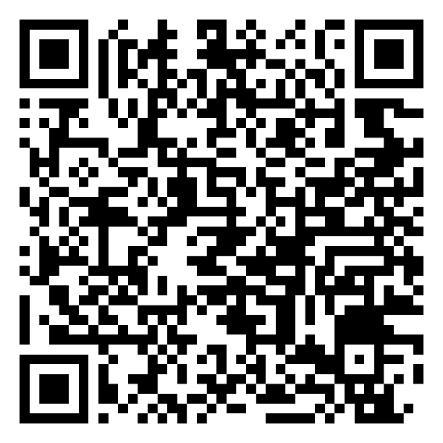
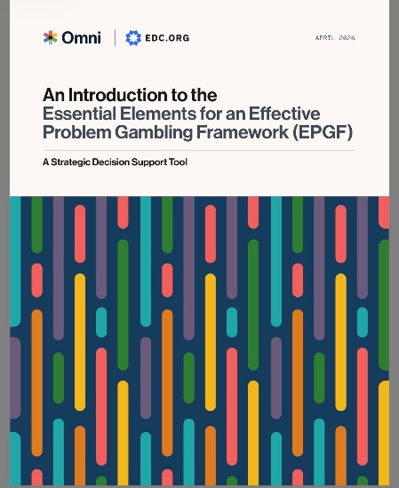
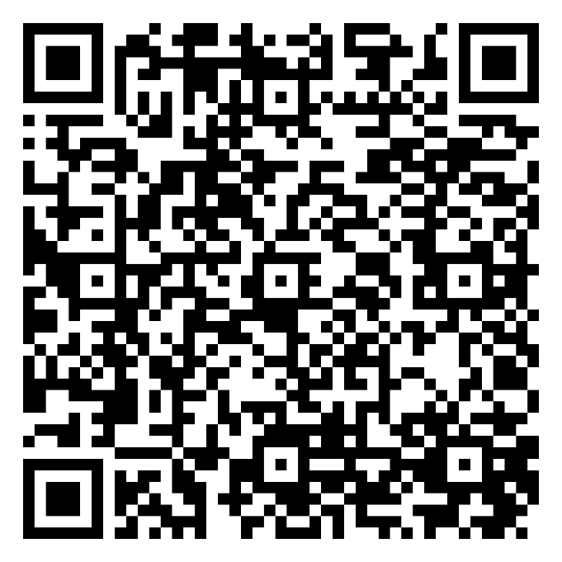
To Get the PPT
To Download the Tool
https://solutions.edc.org/solutions/prevention-solutions/events/conference-focus-future-2026

Slide 29



Let’s Connect!
Chuck Klevgaard (he/him)
Project Director, EDC
cklevgaard@edc.org
T Schweimler (they/them)
Research Manager, Omni Institute
tschweimler@omni.org
Notes:
Chuck

