Slide 1

Capturing Your
Community’s Voice
A Roadmap from Data Gathering to Resource Development
Notes:
R

Slide 2
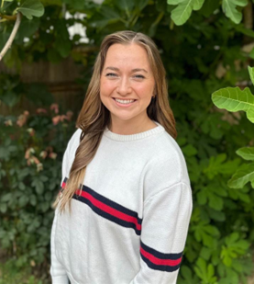
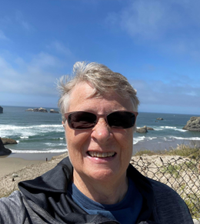
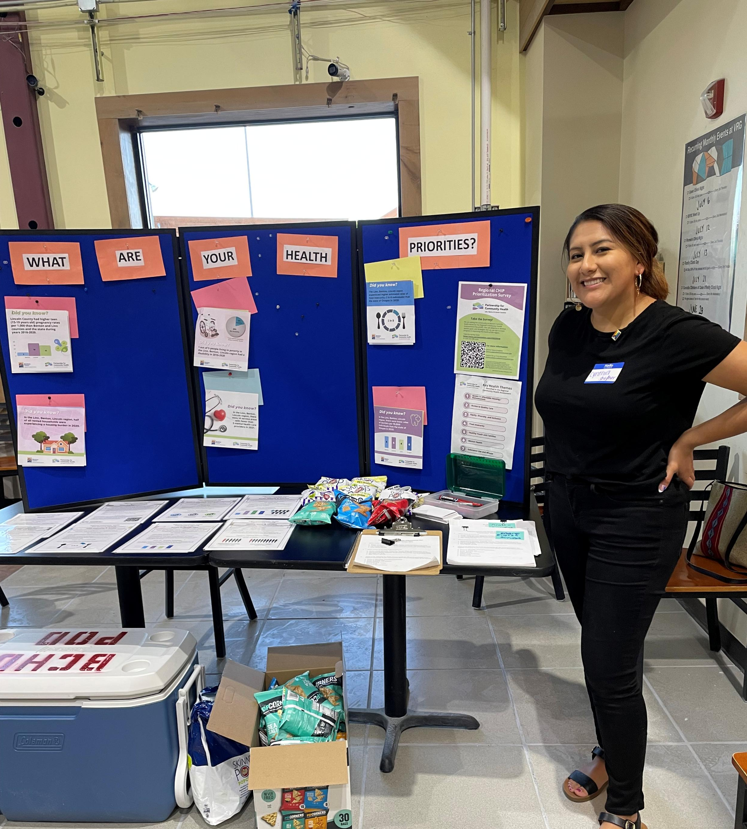
Cynthia De La Torre
Benton County Health Dept
PG Prevention Coordinator
Paige Vazquez
Problem Gambling Solutions
Roxann Jones
Oregon Health Authority
Problem Gambling Specialist
Notes:
R

Slide 3
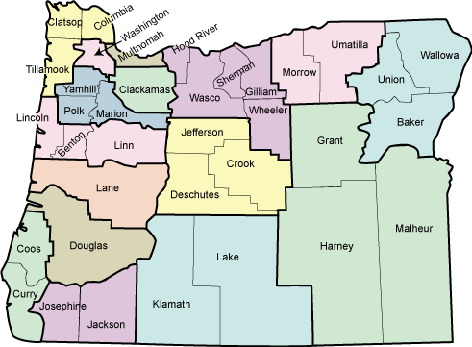
Welcome to Oregon
Population 4.27 million
Vast geography ranging from ocean, rivers, lakes, dense forest and high desert region
Approximate Race & Ethnicity
  White (Non-Hispanic) 71%
  Hispanic/Latino 14.7% - 15.5%
  Two or More Races: 6.1%
  Asian: 4.4%
  Native American/Alaska Native 1.1% - 1.6%
Notes:
R -

Slide 4
How We Started – Need for Data
The issue:
Gambling in Oregon is highly accessible, making young people particularly vulnerable.
Elevating youth gambling to a public health priority was essential.
Data Gaps
Existing data lacked depth on awareness, perceptions, and attitudes among youth and parents/caregivers.
Without these insights, prevention strategies risk being less effective.
Notes:
R

Slide 5

Why Data Matters
Data tells our story and provides meaningful insights to support prevention strategies.
Notes:
P

Slide 6

What We Decided to Do
Community-Engaged Focus Group Research
Notes:
P -

Slide 7
Next Steps
              Development of application process and recruit prevention teams to host focus groups with:
                Middle- or high-school-aged youth
                Parents and caregivers
                Host Town Hall for all problem gambling prevention specialist to provide feedback on focus group questions.
                Train focus group team leads on facilitation and recruitment best practices
Refine and finalize questions for youth and parent/caregiver focus groups
Recruitment participants for focus groups
Notes:
P-

Slide 8
Prevention Expert Consultation
Objective: Gather observations & research priorities from prevention experts across Oregon to collaboratively design effective focus group questions.
Subject Matter Expert Townhall
Gather observations and research questions from problem gambling prevention specialists across the state
Townhall Debrief
Review notes with project preventionists
Collaboratively develop strong, effective focus group questions
Notes:
P - What have you observed about youth gambling in your communities?
What prevention tactics have you implemented or observed? What was helpful/unhelpful about them?
What do you want to know from parents and caregivers of youth about youth gambling?
What information would be most useful for youth gambling prevention in your communities?

Slide 9
Focus Group Question Development
Objective: Review notes from the subject matter expert town hall, determine research priorities for youth and parent/caregiver groups, and formulate focus group questions
Research Priorities: Youth
Collecting youth gambling behavioral data
What are youth perceptions about gambling?
What is actually helpful for youth in gambling prevention?
Are they interested in learning more about gambling? Seeing the data?
Focus Group Question (Draft)
What does gambling look like in your world?
Are you engaging in gambling in gaming and/or sports betting?
What have you seen on social media or television about gambling?
Have you ever had a conversation with a parent or mentor about gambling?
Notes:
P

Slide 10

What We Asked Youth
What do you know about gambling?
Can you share any stories or experiences you've heard about peers gambling in your community or at schools?
[Define gambling]
What games have you played that feel like gambling?
How do you think gambling is connected to other risky behaviors, like alcohol or drug use?
Where do you see or hear about gambling the most—at home, at school, on the internet, or somewhere else?
Have you ever talked to an adult, like a parent or teacher, about gambling?
Notes:
P

Slide 11
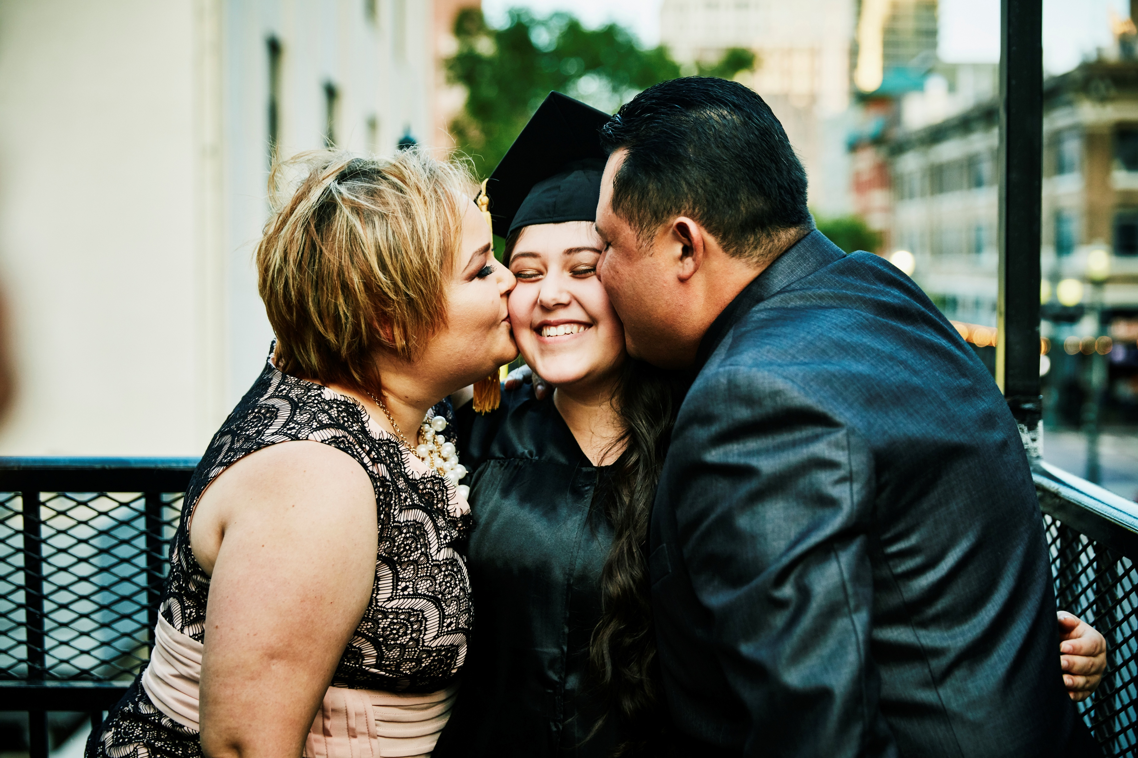
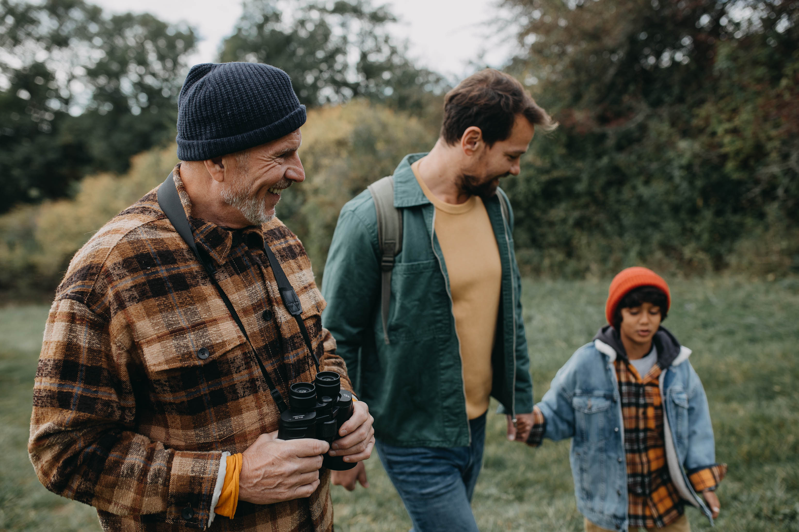
What We Asked Parents/Caregivers
Can you share any stories or experiences you've heard about youth gambling in your community or at schools?
[Define gambling]
In what ways do you think youth are being exposed to gambling, whether it’s through media, friends, or other influences?
What steps do you take in your own home to limit exposure to gambling?
What strategies have you seen or heard about that parents or schools are using to help protect youth from exposure to gambling?
How do you think gambling might be linked to other risky behaviors in young people, such as substance use or harmful behavior?
Notes:
P

Slide 12

Focus Group Moderation Training
Objective: Equip local prevention experts to facilitate effective focus groups
Training Curriculum
Focus groups for research
Moderator role
Notetaker role
Planning and preparing for a focus group
Introduction to analyzing and reporting findings
Notes:
P

Slide 13

Recruitment Strategies
Make participation easy
Remove participation barriers
Use diverse outreach channels
Make outreach messages simple and inviting
Partner with existing community connectors
Use incentives
Tailor recruitment to each audience’s communication habits
Follow up to reduce no-shows
Build trust by being transparent
Over-recruit
Notes:
R -

Slide 14
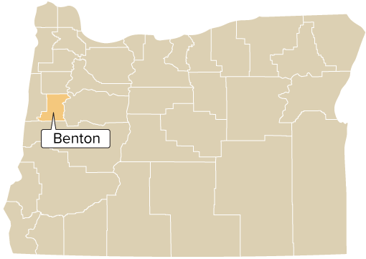
Meet Benton County
Population: ~97,728 (2025)
Demographics: White non-Hispanic (77%) Black (2%) American Indian/Alaskan Native (1%), Asian (7%) Native Hawaiian and/or other Pacific Islander (0.3%) Multiple Races (4%) Latino/Hispanics (10%)
Major cities: Corvallis, Philomath, Monroe, Alsea, North Albany, and Adair Village
Landscape: Urban (Corvallis), Rural
Economic Industries: Agriculture, forest products, research and development, electronics, wineries
Notes:
C

Slide 15
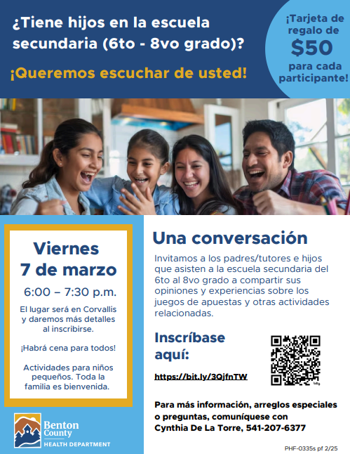
Recruitment – Local Level
Focus population: Latino youth and Latino parents/caregivers
Partnered with bilingual school health navigator placed at a local dual immersion middle school
Decided to hold focus groups with Latino youth and Latino parents/caregivers on the same date/time in the same setting (the middle school)
Created a flyer and school staff supported outreach recruitment
Community safety concerns around immigration
Incentives to meet community needs: gift-card, activities for children during the focus group, dinner
Notes:
C

Slide 16
What strategies would you use to recruit individuals from your identified population for a focus group?
We want to learn from you!
Notes:
C – interactive activity

Slide 17
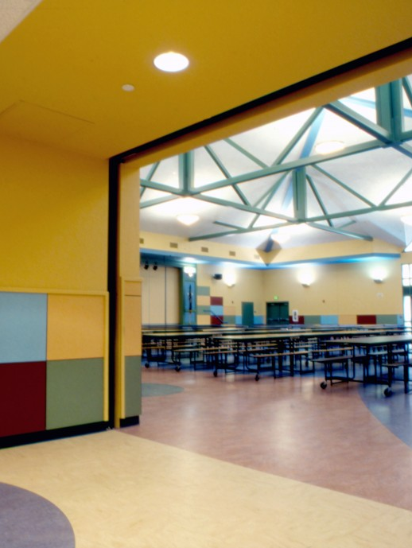
Conducting Focus Groups
Focus groups held simultaneously at Linus Pauling Middle School in Corvallis, OR: parents/caregivers and youth in different locations
Each group supported by one facilitator and one note-taker
Team members were bilingual (English/Spanish) and bicultural (Latin America/United States), helping build trust and rapport
Sessions opened with ice-breakers or dinamicas to encourage comfort and participation
Schedule: 20 minutes for dinner, 10 minutes for introductions and consent review, and 1 hour for discussion
Zoom used for audio recording
Notes:
C

Slide 18

Parent/Caregiver Focus Group
People in the room:
Conducted in Spanish
Facilitator(s): Latina parent, Latina young adult with Latino immigrant parents
Most participants were immigrants from Mexico and Central America
Equal representation of moms and dads (not as typical)
Image from KQED.org
Notes:
C

Slide 19

Parent/Caregiver Focus Group - Highlights
Challenges with defining “problem gambling” in Spanish
Engagement was strong, and participants motivated to continue the conversation
A major theme was concern about digital devise use and overall digital safety.
Parents identified a need for practical digital wellness strategies for youth
Parents also expressed interest in digital education tools to help reinforce expectations at home.
Notes:
C

Slide 20

Youth Focus Group - Population
People in the room:
Conducted in: English, Spanish, Spanglish
Facilitator: Latina, 25 years, shared she had a little sister of similar age as the youth
Note-taker: Latino immigrant parent
Youth knew each other which may helped conversation
Motivational interviewing techniques used
Notes:
C

Slide 21
Youth Focus Group - Highlights
"It was like having a conversation with my little primos and primas” ~ facilitator
Youth generally understood gambling, though some viewed certain activities as low-stakes fun
Once definitions were aligned, youth easily connected the topic to their family, school and community
Scripted questions helped youth form their own conclusions
Youth raised questions about their social environment including scams, ads, losing sleep or time on digital devices and games
Youth questioned whether parents were having the same conversation
“I know my parents are going to say I’m addicted to my phone, but I don’t know what else to do” ~ youth participant (in transition not recorded)
Notes:
C

Slide 22

Follow-Up Consultation
Science Translation & Applying Findings to Meaningful Work
Webinar provided several months following the published reports for all prevention specialists across the state
Introduction to science translation of the focus group findings
Dissemination strategies for community and professional audiences
Ideas to develop tools and practice using focus group findings
Notes:
P

Slide 23
Data Analysis
Quantitative (surveys) & qualitative (focus groups)
Survey Data
Low response rates
  Parent/caregiver = 16
  Youth = 7
Reported descriptive statistics
Focus Group Data
Audio transcriptions + notetaker and moderator notes/comments
Thematic analysis conducted by the research consultant
Findings reviewed by and discussed with those who conducted the groups
Refined
Notes:
P

Slide 24
How Have the Findings Been Used?
Reports published by OHA, presented at webinars and conferences
Findings used to inform prevention toolkit development (funded by an agility grant from the National Council on Problem Gambling, awarded to the Oregon Council on Problem Gambling)
Prevention specialists report:
  Referencing the results when sharing local (e.g., county-level) data
  Developing educational resources
  Inspiring future initiatives
  Informed approach to talking about gambling with youth
Notes:
P

Slide 25
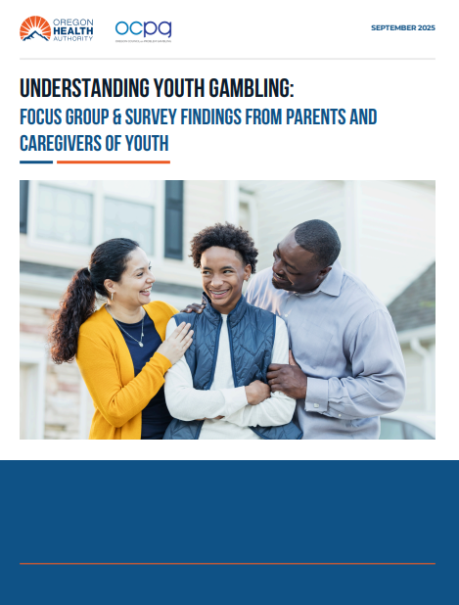
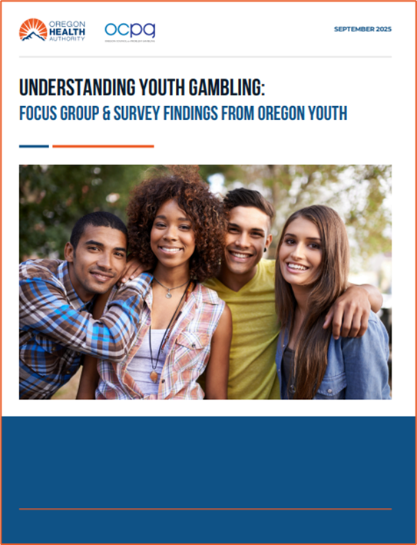
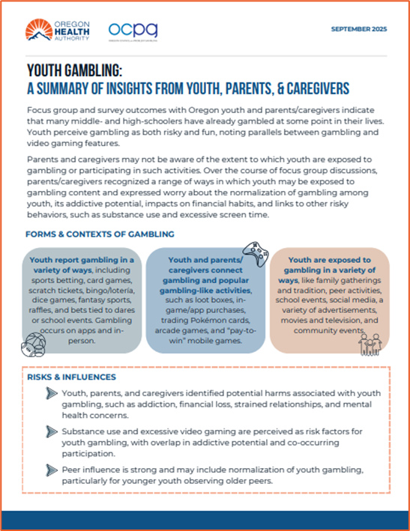
Results: Youth and parent/caregiver focus group
Notes:
R -

Slide 26
Focus group project insights
Many Oregon youth have already tried gambling.
Youth prefer learning from teachers, parents, and social media
Youth view gambling as both risky and fun, and identify the similarities to video games
Parents & caregivers underestimate youth exposure to gambling
Concerns include normalization, addiction risk, financial impacts, and links to other risky behaviors
Parents & Caregivers want toolkits, culturally relevant resources, and guidance for conversations
Notes:
R -

Slide 27

From youth
Youth felt it’s important to learn about gambling risks and felt at least somewhat confident they could find help if needed.
Two-thirds want more information about gambling, and it’s impacts on people their age.
Two-thirds have searched out information about addiction; all used internet searches, half consulted a trusted adult, and half used social media resources.
Notes:
R-

Slide 28

From the parents & caregivers
Many parents believe gambling education should begin early – often before middle school.
Parents with middle – or high schoolers are more likely to view youth gambling as a problem.
Two –thirds have talked with their children about gambling, regardless of their level of concern.
Overall awareness of youth gambling is low.
Limited prior knowledge led parents to explore related concerns such as excessive screen use, social-media wagering, gambling-promoted apps, and youth confusion about what counts as gambling or it’s legal age.
Notes:
R -.

Slide 29


How would you use the data
Ideas
Identify key themes
Pull out representative quotes
Combine findings across groups
Highlight gaps or contradictions
Connect themes to action
Use focus group data as complimentary evidence
Create a clear summary
Share back with participants
Notes:
C -

Slide 30
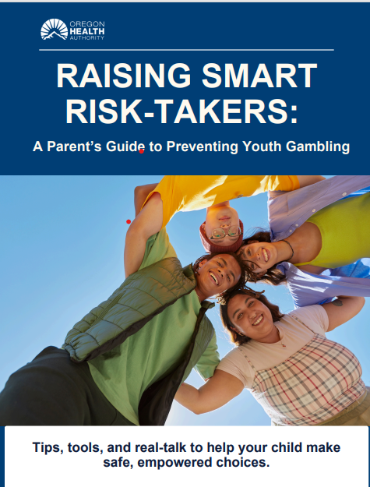
Parent Guide to Preventing Youth-Gambling
Supports parents in navigate the joys and challenges of raising confident, healthy, and resilient children.
Offers practical, heart centered strategies to strengthen parent-child connections.
Provides tools for setting healthy and consistent boundaries
Includes prompts to spark meaningful, everyday conversations.
Helps parents build their child’s confidence to make safe, empowered choices.
Notes:
R -

Slide 31

Other resources
Oregon Council on Problem Gambling
Community Guardians
Financial Literacy Toolkit
Community Guardians is an initiative funded through a National Council on Problem Gambling (NCPG) Agility Grant that focuses on reducing gambling-related harm by strengthening the role of community leaders. The project is grounded in the belief that community-driven solutions are among the most effective ways to create lasting change.
Notes:
P

Slide 32
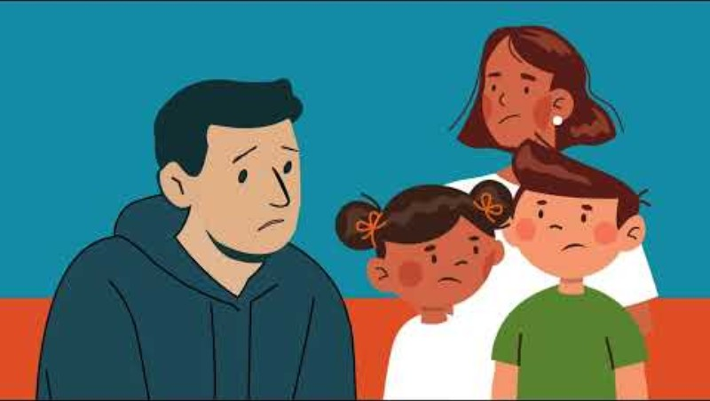
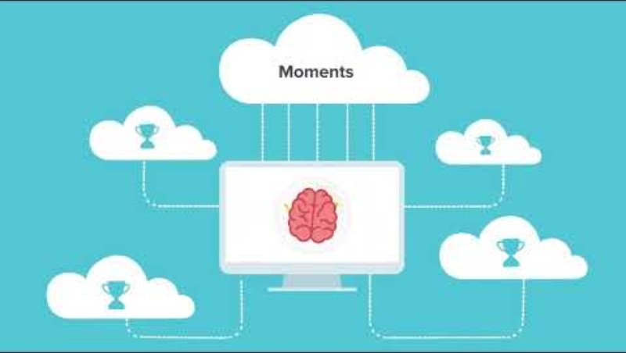
Videos
Notes:
R

Slide 33

Questions?

Slide 34
Resource Links
Understanding Youth Gambling: Focus Group & Survey Findings from Parents in Oregon
Understanding Youth Gambling: Focus Group & Survey Findings from Youth in Oregon
Youth Gambling: A Summary of Insights From Youth, Parents, & Caregivers
Raising Smart Risk Takers: A Parent’s Guide to Preventing Youth Gambling
CRIANDO TOMADORES DE RIESGOS INTELIGENTES: Consejos, herramientas y conversaciones sinceras para ayudar a su hijo a tomar decisiones seguras con confianza. Guía para Padres sobre la Prevención del Juego en Jóvenes
Community Guardians Oregon Council on Problem Gambling (OCPG)
Notes:
R

Slide 35



Thank you for joining us today! Please do not hesitate to reach out if you have any questions.
Cynthia De La Torre
Benton County Health Dept
PG Prevention Coordinator
Cynthia.Delatorre@bentoncountyor.gov
Paige Vazquez
Problem Gambling Solutions
paige@problemgamblingsolutions.com
Roxann Jones
Oregon Health Authority
Problem Gambling Specialist
Roxann.r.jones@oha.Oregon.gov
Notes:
R

