Slide 1


The True Impact of Gambling on AAPI Individuals, Families, and Communities
Timothy W. Fong MD
UCLA Gambling Studies Program
Four Directions Conference
September 21, 2023

Slide 2
Financial Disclosures
None

Slide 3
Objectives
Name three cultural themes among AAPI communities that increase risk for gambling disorder
Be able to demonstrate screening and assessment techniques from AAPI clients and their families focused on identifying gambling behaviors
Learn three office-based techniques that will engage and retain AAPI clients and their families impacted with gambling disorder

Slide 4
Mary and John:
Trouble With Father
Mary and John come in for consultation about father’s gambling
They are 2nd generation Taiwanese-American, both executives / professional
Father is retired businessman
They are concerned about escalating gambling losses

Slide 5
Mary and John:
Trouble With Father
Main areas of inquiry:
  How do we get help for our father?
  How do we protect family’s assets?
  How do we support our mother?
  What are we supposed to do to help make this situation better?
  Do we give money when asked?

Slide 6
Asians and Gambling

Slide 7
Asian Pacific Islander
A person with origins in any of the original peoples of the Far East, Southeast Asia, South Asia or the Pacific Island

Slide 8
Asian American
Asian American Pacific Islander
Asian American
Asian Pacific American
Asian or Pacific Islander
APIDA (Asian Pacific Islander Desi American)
  ~5% US Population
  ~13% California

Slide 9
One Chinese proverb demonstrates the culture’s acceptance of gambling, at the same time signaling a warning to those who overindulge:
“A little gambling is soothing and relaxing; heavy gambling could affect your mental health”.

Slide 10
Cultural factors that promote gambling
  Acceptable way to make money
  Inquire about one’s destiny
  “Honoring the Gods”
    Losses are sacrifice
  Equate gambling with self-worth and ability to move up classes

Slide 11
Cultural factors that promote gambling
  Emphasis on numbers that have power over life events
  Heavy peer involvement
  Gambling is family entertainment
  Gambling as a rite of passage
  Superstitions

Slide 12
Immigration
The experience of immigration – including any experience of trauma and subsequent stresses of adaptation contribute to greater likelihood of problem gambling.
  Loss
  Loneliness / isolation
  Status seeking

Slide 13
What about the gambling industry?
Gambling establishments frequently shuttle potential patrons from communities with large Asian populations (Chinatown, Koreatown, etc.) to their facilities.
Bilingual staff in order to increase comfort and ease of their Asian patrons.
Targeted events, lounges, facilities, offers

Slide 14
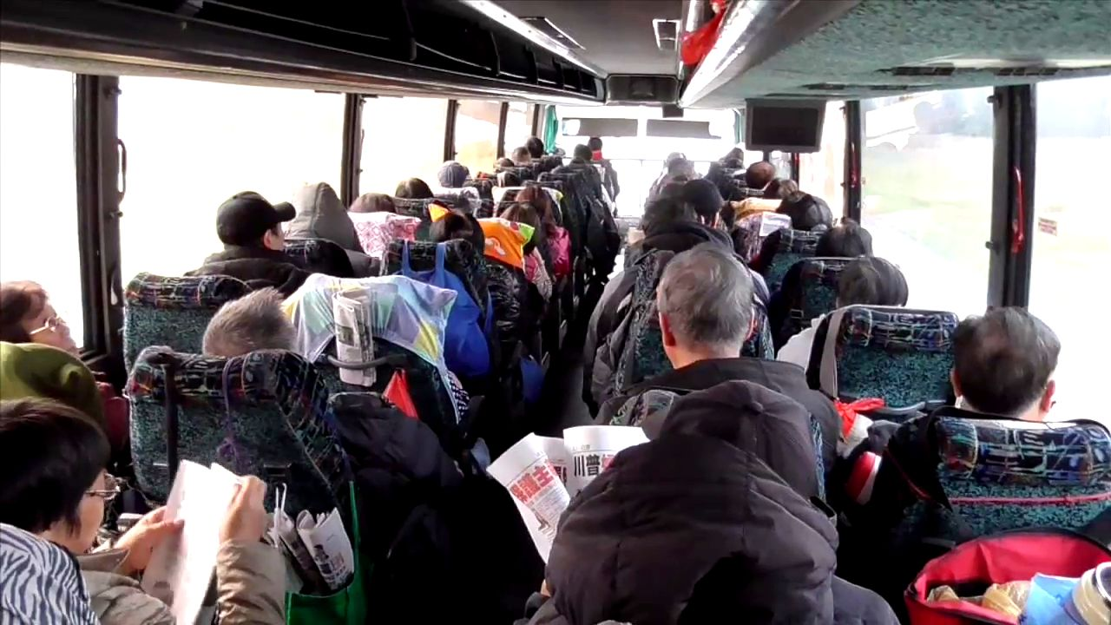

Slide 15
Nancy Petry Study 2002
Study on 96 Cambodian, Laotian and Vietnamese refugees
  59% identified as pathological gamblers. (1.5% California rate)
  95 % reported gambling in the previous year, and 93% reported gambling in the previous two months.

Slide 16
2005-2021
Asians and Gambling
2000-2010
  Early recognition that API communities may have elevated rates of problem gambling
  Growing attention to API public awareness campaigns about gambling disorder
  Funding for this work sporadic, not sustainable
  NICOS (SF), Philadelphia, Massachusetts

Slide 17
2010-2020
Increasing funding by states for gambling disorder
Ongoing but intermittent work on Asians and Gambling (variety of perspectives)
Continued, expanding growth of gambling throughout the country

Slide 18
2023 Issues
Will demand for gambling return?
  Domestic
  International
Will “Asian Marketing” remain?
How do AAPI relate to online gambling market?
AAPI gambling amongst Millennials and Generation-Z

Slide 19
California Prevalence Study (2006)
Asians (504)
  Low response rate (47% overall, less APIs)
  7% of survey sample
  Mostly English (1% translated)
  Problem Gambling: 2.3%
  Pathological Gambling 0.7%
  Less aware of helpline

Slide 20
Prevalence of Asian Gambling in Casinos

Slide 21
Results
Gender | N=180
Male | 75%
Females | 25%
Ethnicity
Asians | 37% Chinese, Filipino, Korean, Japanese
Non-Asians | 63%

Slide 22
Results
Screening Score | APIs | Non-APIs
SOGS >5 | 42% | 36%
NODS >5 | 35% | 26%

Slide 23
PG Alliance San Jose Community Survey 2011
Gender:
  Male-574 (40%),
  Female-828 (57%), N/A 61 (3%)
Race:
  Vietnamese-374 (27%),
  Filipino-201 (14%),
  Chinese-145 (10%),
  Mexican-278 (19%)

Slide 24
Results
PG Prevalence (%)
San Jose (Gen Pop)
  At Risk: 6.5
  Problem 2.4
  Pathological 1.4
San Jose (API)
  At Risk: 6.5
  Problem 0.7
  Pathological 3.4

Slide 25
Help Seeking Behaviors & Barriers
(PG Alliance San Jose Community Survey 2011)
APIs reported > non-APIs
  Very Difficult to talk about
  I Would not discuss my problems
Barriers to Treatment
  No Money
  Shame
  No idea where to go

Slide 26
Community Awareness
84% said PG is an addiction
40% had not heard of treatment resources
Likely sources
  Media
  Friends / Family
  Helpline

Slide 27
King SM, Wasberg SMH, Wollmuth AK. Gambling problems, risk factors, community knowledge, and impact in a US Lao immigrant and refugee community sample. Public Health. 2020 Jul;184:17-2

Slide 28
(King 2020)
SOGS score of five or more = 24%
Among those endorsing five or more gambling problems, reasons for gambling included m
  making money (68%),
  social life (31.3%),
  entertainment (58.3%)
  reducing boredom (35.4%).
Less commonly endorsed reasons were depression or stress (14.6%) and escape (10.4%).

Slide 29
Talking about Casino Gambling: Community Voices From Boston Chinatown
Carolyn Wong, Ph.D.
Institute for Asian American Studies, University of Massachusetts Boston
Giles Li, M.P.A.
Chief Executive Officer, Boston Chinatown Neighborhood Center
For the Massachusetts Gaming Commission October 24, 2019

Slide 30
Exec Summary
“Many of interviewees described varying degrees of dependency on gambling in casinos to relieve the drudgery of work in low-paying jobs in the food service industry, and the isolation of life in linguistically isolated neighborhoods with few alternative opportunities for recreation”

Slide 31
AAPIs and Treatment

Slide 32
Barriers to Overcome
Language
1 in 2 Asian Americans suffering from mental illness will not seek help due to a language barrier. (APA Commission of Ethnic Minority Recruitment, Retention, and Training)
Generational Considerations
Asian Americans born in the United States are at higher risk for mental illness as a result of assimilating to American culture and its clashes with Asian values, usually enforced by elder family members. (National Latino and Asian American Study)

Slide 33
Barriers to Overcome
Cultural Biases
Many cognitive screening tests have cultural and linguistic bias, making it difficult to diagnose Asian American patients, especially elderly. (Professional Psychology: Research and Practice, 2005)
Model Minority Myth
The high education and economic status of most Asian Americans places them out of many underserved areas and takes focus away from their growing mental health care needs. (Surgeon General’s Report, 2000)

Slide 34
Cultural Issues in Treatment
API Gambling Disorder
  redeem losses, peer influence, thrill, emotional problems, stress and boredom
    (Teo et al. 2007)
  claim that they are winning even when they are losing a lot of money.
  illusion of control than the Caucasians
    (Loo et al. 2008)
  hold more strongly onto the beliefs in fate and luck than other cultural groups

Slide 35
Cultural Issues in Treatment
Familial socialization may have passed on the values and beliefs about gambling to the next generation (Loo et al. 2008).
Second, Chinese families has a strong tendency to conceal the presence of a family member with problem gambling and to rescue him/her by paying his/her debts.

Slide 36
What is the Antidote to Stigma?

Slide 37
Education and Empathy

Slide 38
Best Practices To
Reduce Stigma
Assess language barrier
Ask about traditional beliefs and values about health and illness
Active participation in care (e.g. blood pressure, administer injections)
Involve family as a unit
Ethnopsychopharmacology

Slide 39
California Gambling Education and Treatment Services (CALGETS) problemgambling.ca.gov

Slide 40
Treatment Options
Prevention
Self-help
Telephone Interventions
  Helpline services
Office-based treatment
Group treatment
Intensive Outpatient
Residential Treatment

Slide 41
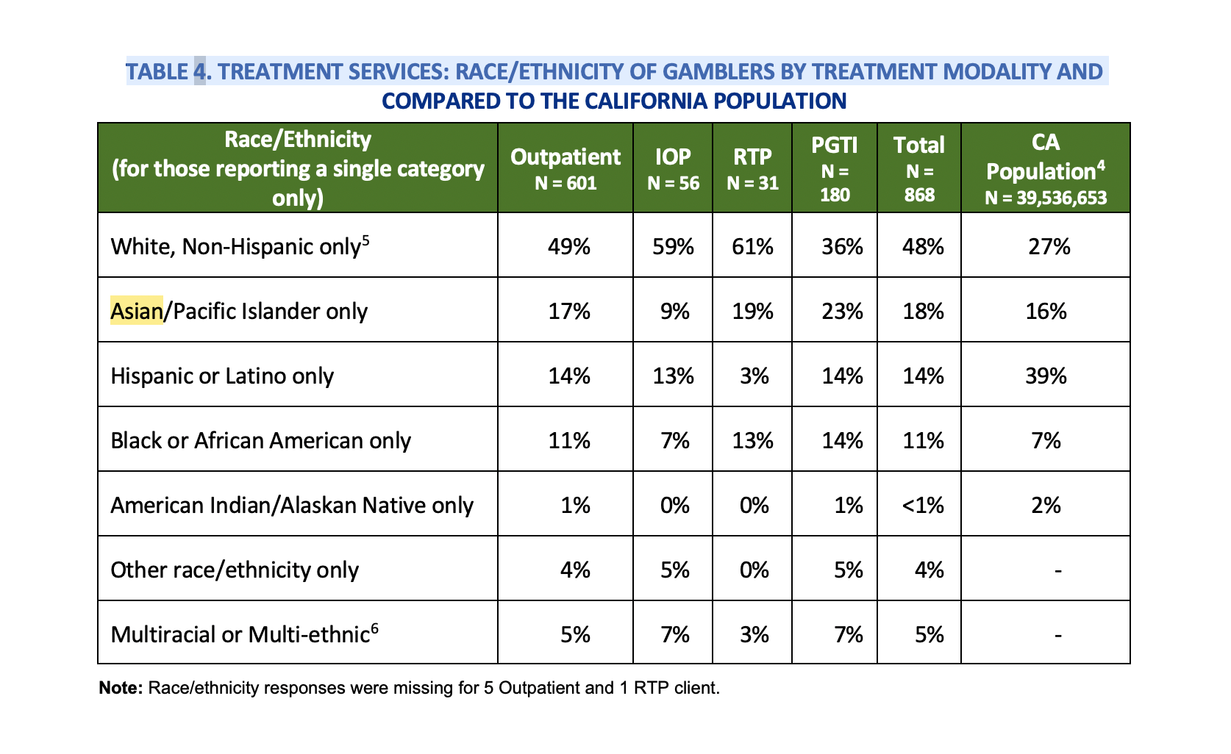
CALGETS Demographics

Slide 42
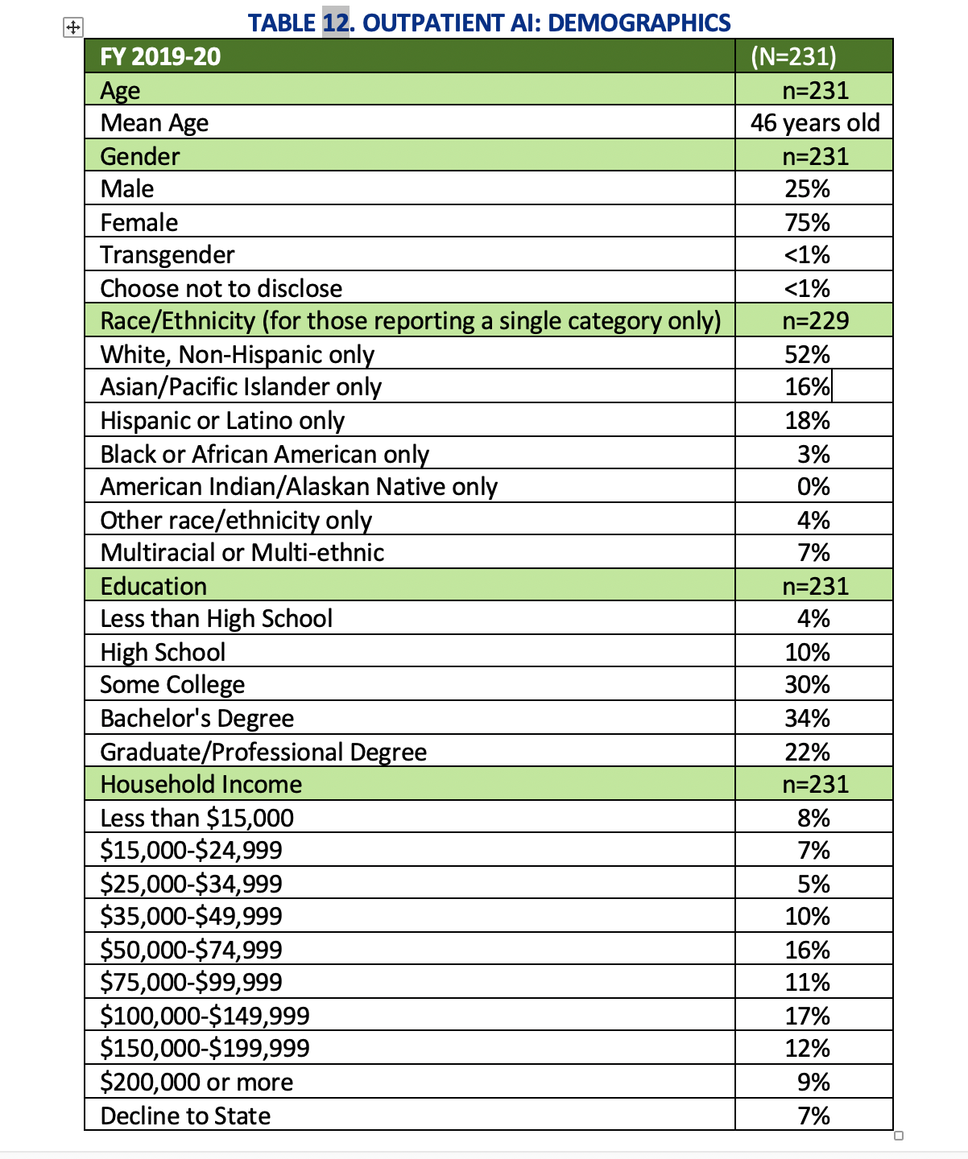

Slide 43
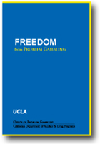
Freedom From
Problem Gambling Workbook

Slide 44
Available Languages for WB
Arabic | Hmong | Russian
Armenian | Japanese | Samoan
Cambodian | Korean | Spanish
Chinese | Laotian | Tagalog
English | Lu Mien | Thai
Farsi | Punjab | Vietnamese

Slide 45
Treatment Principles

Slide 46
Prevention Ideas
Effective early intervention strategies much address the culture of acceptance, in order to reshape social norms and learned behaviors
  Teaching the odds
  Building up coping skills
  Demystifying gambling as a sport
  Using technology to promote resilience

Slide 47
Focus on the Family
In many Asian traditions, it is natural for family and community members to help one another – by lending money for debt relief, vouching for a loan, etc.
Asian families may have to get assistance in setting firm boundaries, avoiding codependency, and encouraging gamblers to take responsibility.

Slide 48
What Clinicians Can Do
Proficient in client’s language/dialect, using interpreter only as last resort
Avoid extensive questioning, assessment & evaluation; clarify and explain all procedures
Help client develop measurable and tangible short-term treatment goals
Receptive to Somatic Approach & Pharmacological Treatment

Slide 49
Thoughts on GA
Gamblers Anonymous –
  AAPI-specific groups?
  In-language GA meetings?
    In-person vs. Zoom
  How can participation occur with a cultural lens?
  One-on-one fellowship / sponsor

Slide 50
Eastern Treatment Options
Acupuncture
  Used to be part of residential treatment programs
  No clear data
Eastern philosophies of balance, restoration
  Flushing out negative energy

Slide 51
Fables of Fortune Mural
Eric Okdeh
Fables of Fortune is about problem gambling, particularly within Asian immigrant communities.
The mural shows stories of real people, the cultural aspects of luck and gambling, the challenges problem gamblers face, and the arrival of local casinos and gambling practices that target immigrant communities.
The mural shows a path to recognition of gambling addiction, and the decision to overcome problem gambling. It is a message of hope, recovery, and restored relationships.

Slide 52
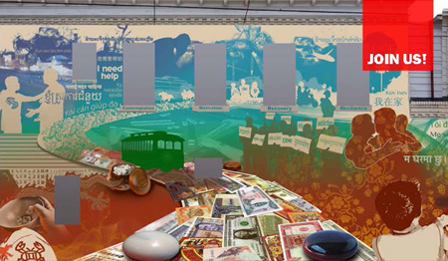
Fables of Fortune
(South Philly)

Slide 53
Innovative Ideas
Partner with casino buses / tour junkets
Create more online tools / apps for APIs
Tie-in with API dining establishments
Partnerships with churches
Establish community “warning networks”
Tell more stories through media / change the conversation
Tie in with other services agencies

Slide 54

Contact Information
Timothy Fong MD
UCLA Gambling Studies Program
310-488-3916 (UCLA Cell)
tfong@mednet.ucla.edu
uclagamblingprogram.org

